Slide 1

User-centered app adaptation of a low-intensity e-mental health intervention for Syrian refugees
Christine Knaevelsrud, Sebastian Burchert, Mohammed Salem Alkneme
Freie Universität Berlin

Slide 2
STRENGTHS
Syrian REfuGees MeNTal HealTH Care Systems
To develop health care implementation strategies
to scale-up the delivery and uptake of effective mental health interventions for Syrian refugees.
Notes:
This is a sub-project of STRENGTHS
Focus on finding effective implementation strategies

Slide 3
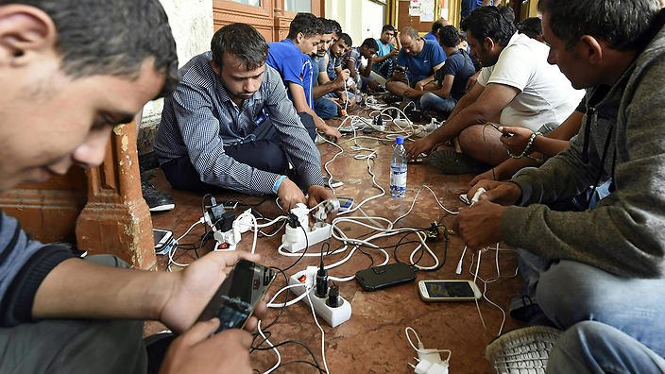
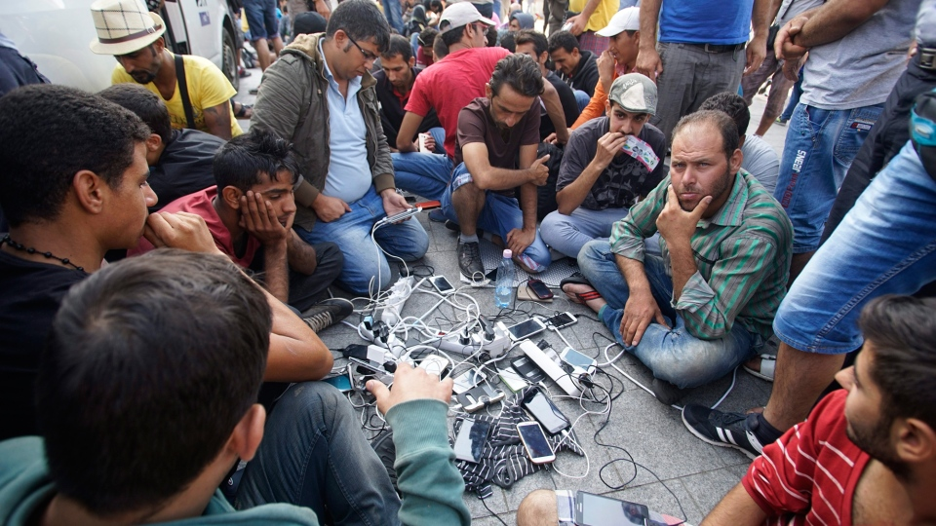
Flight from Syria
The most tech-savvy population of migrants in history.
Rutkin (2016)
(AAP)
Smartphones are among the most important possessions during the flight.
Zijlstra (2017)
(AAP)
(CTV)
Notes:
- Smartphones are a very promising approach to providing help to many people, independent of location/access to healthcare

Slide 4
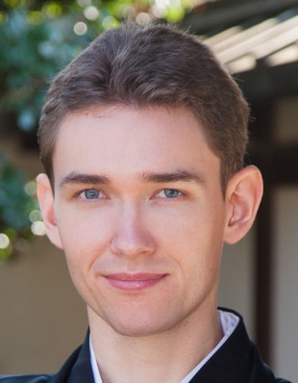
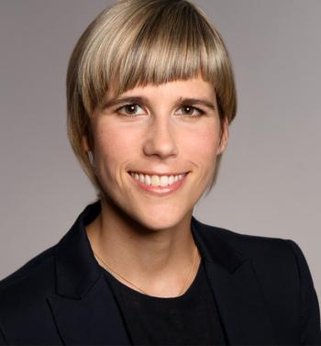
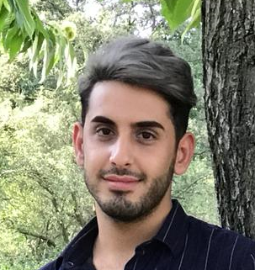
STRENGTHS
Work Package 6 “Online Implementation”
To create an e-mental health intervention for Syrian refugees as a scaling-up strategy in Germany, Sweden and Egypt.
Sebastian Burchert
Christine Knaevelsrud
Mohammed Salem Alkneme
Notes:
- We are Work Package 6

Slide 5

Step-by-Step

Slide 6

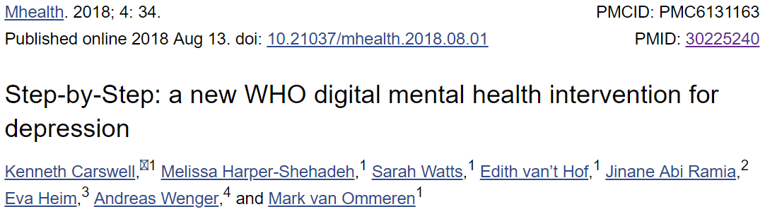


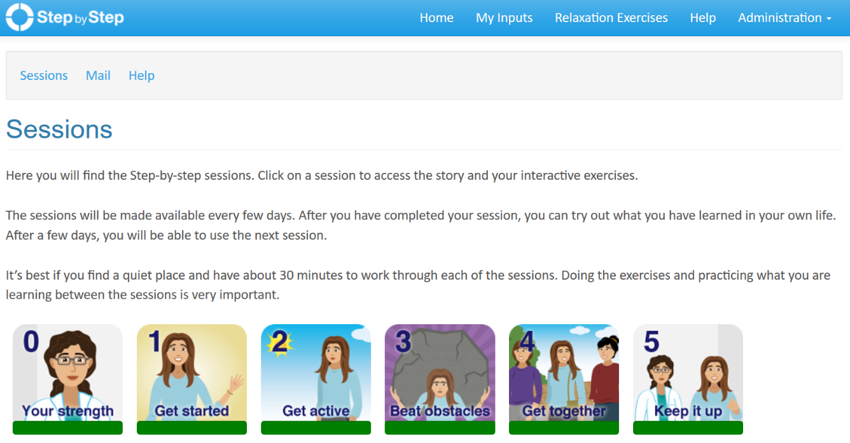
The basis for our work in STRENGTHS
Original intervention concept by the World Health Organization
Eva Heim
Philip Noun
Jinane Abi Ramia
Edith van‘t Hof
Ken Carswell
Rasha Abi Hana
Pim Cuijpers
Rabih El Chammay
Mark van Ommeren
Notes:
- we work with the WHO intervention Step-by-Step (the intervention that was presented by Eva and Philip before)
- close cooperation with WHO and the team in Lebanon
- adaptation of the first version of Step-by-Step (= web version developed in Zurich)

Slide 7
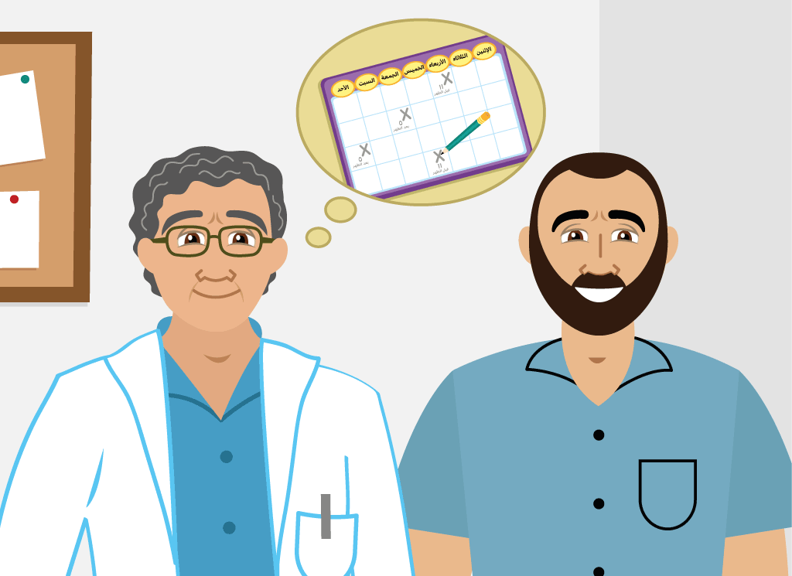
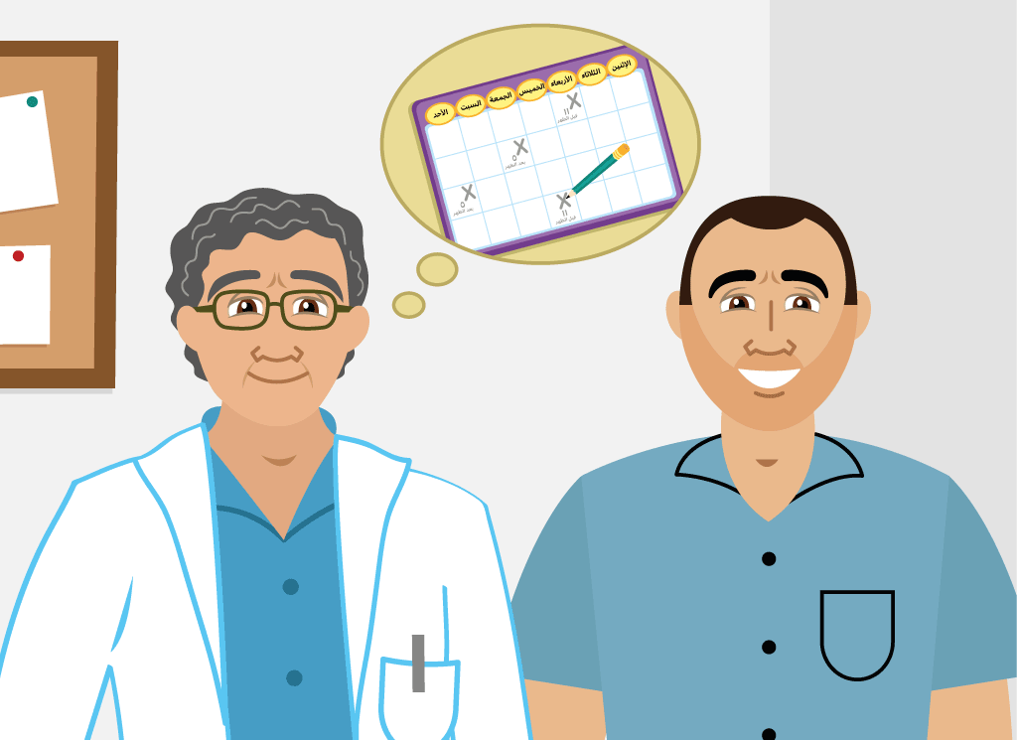


Step-by-Step
Illustrated psychoeducative content
i

Slide 8
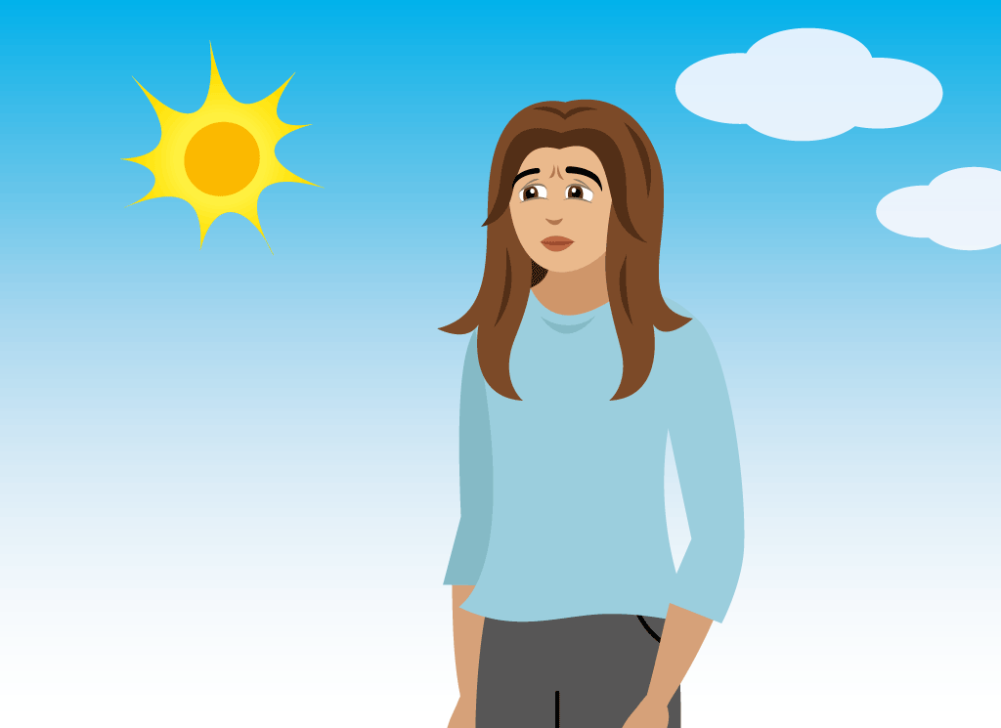
Step-by-Step
Texts in Levantine Arabic Dialect
i
“Dr Maha encouraged me to do one small thing each day that would make me feel a little better, like going for a walk or doing a relaxation exercise, just like she taught you last time.”
شجعتني الدكتورة مهى كمان إنو أعمل شيء صغير بريّحني شوي يومياً، متل المشي أو تمارين الاسترخاء، متل ما علّمتك المرّة الماضية.

Slide 9
Step-by-Step
Interactive exercises
i
Behavioral activation
Slow breathing and grounding audio exercises
Kind words and gratitude lists
Warning signals
Mood tracking

Slide 10
How-to adapt

Slide 11
User-centered Design
IDEAS framework (Mummah et al., 2016)
How-to:
Create prototypes
Do user testing
Repeat

Slide 12
Timelapse

Slide 13

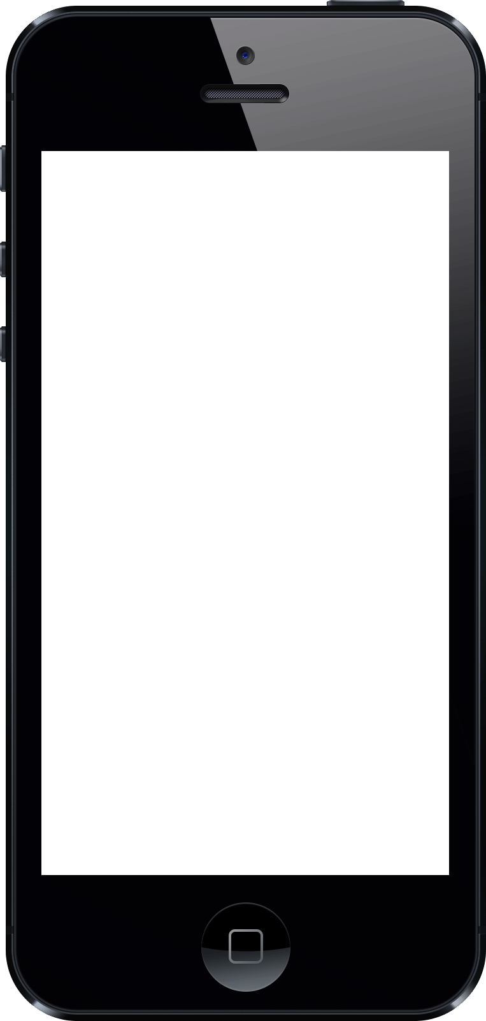



Timelapse (1)
2017 early drafts
rate mood
Item 1
1
2
3
4
pick an activity
Item 2
pick a day
1
2
3
4
pick a time
Item 3
rate mood
1
2
3
4

Slide 14
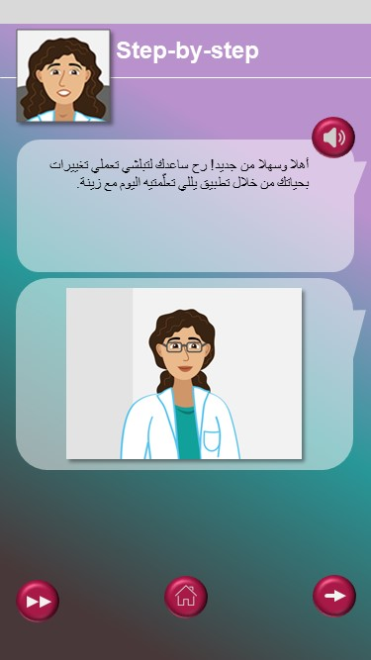

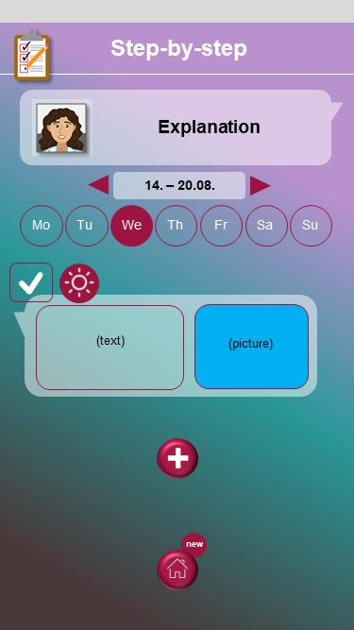
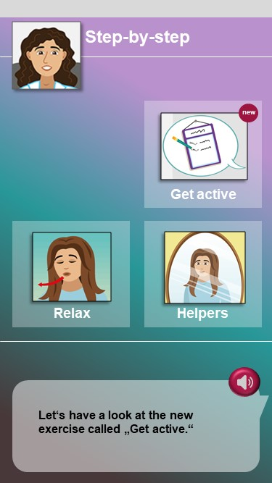
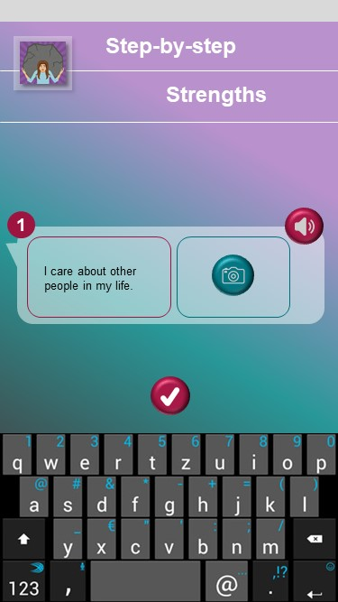
Timelapse (2)
2017 mockups

Slide 15
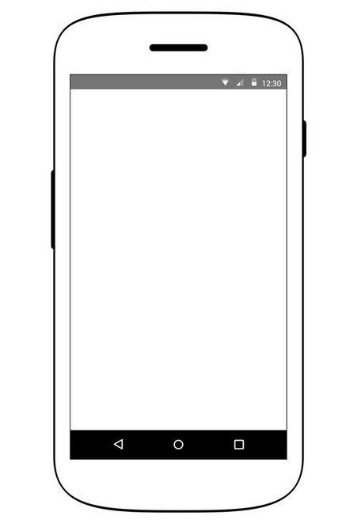
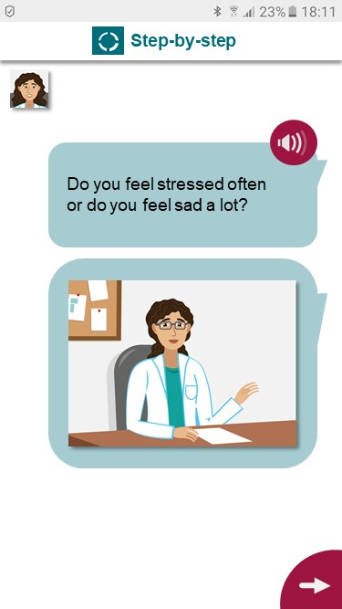
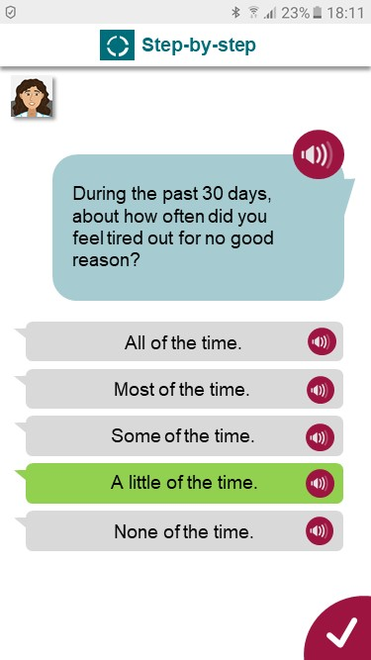
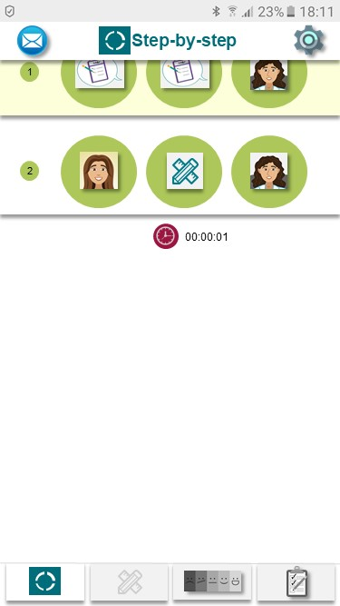
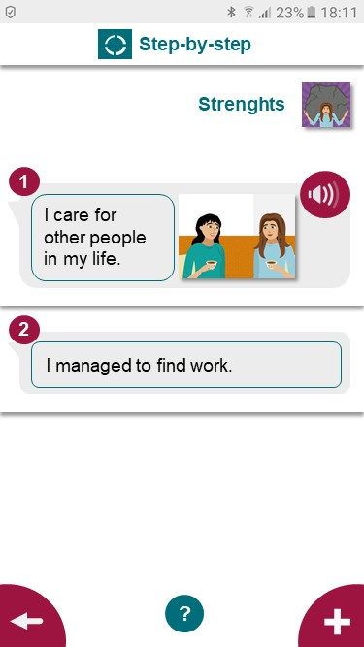
Timelapse (3)
2018 mockups

Slide 16
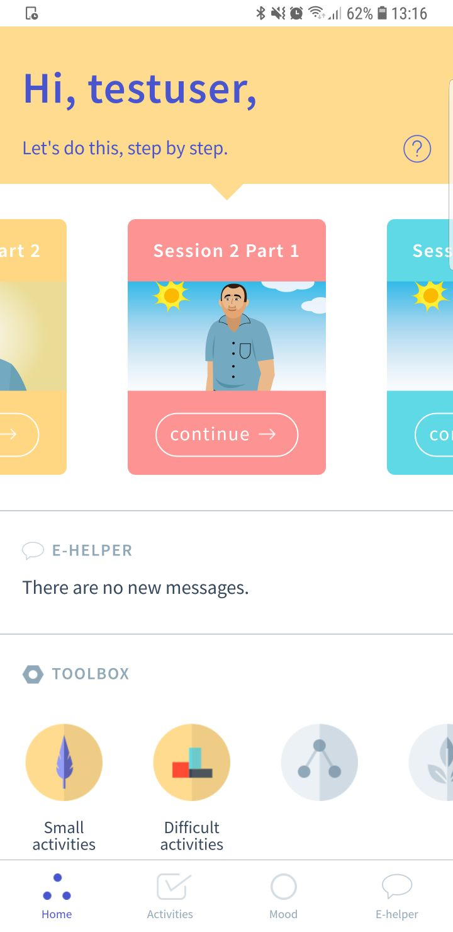



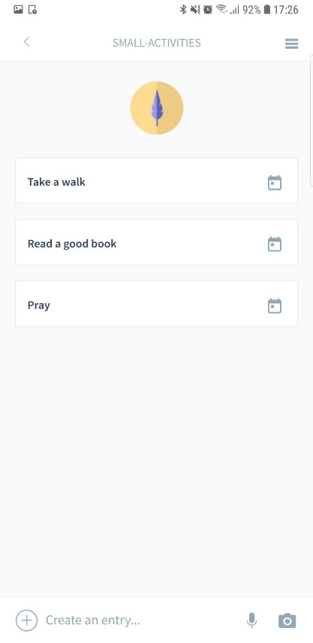
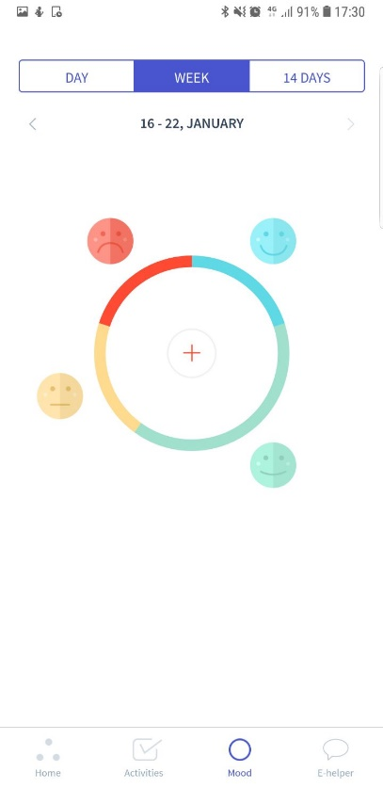
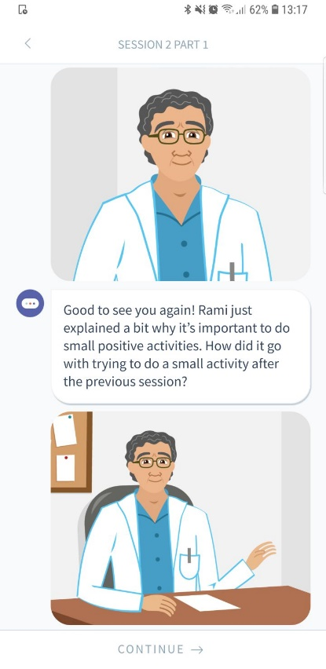
Timelapse (4)
2019 pilot version app

Slide 17
How did we get there?
Part 1: Free List Interviews
Notes:
- We asked Syrians (20 per country) what technologies they use and what problems they encounter using these technologies

Slide 18



Findings
Free List Interviews (N = 60 Syrians)
Commonly used
technologies
Facebook (70%)
YouTube (35%)
WhatsApp (30%)
Facebook (95%)
WhatsApp (65%)
Government-Apps (45%)
WhatsApp (100%)
Facebook (80%)
Viber (70%)
Common problems with technologies
Language (40%)
Internet access (35%)
Technical literacy (25%)
Technical literacy (50%)
Language (35%)
Cost of internet (70%)
Internet access (50%)
Technical literacy (40%)
Cost of smartphones (25%)

Slide 19
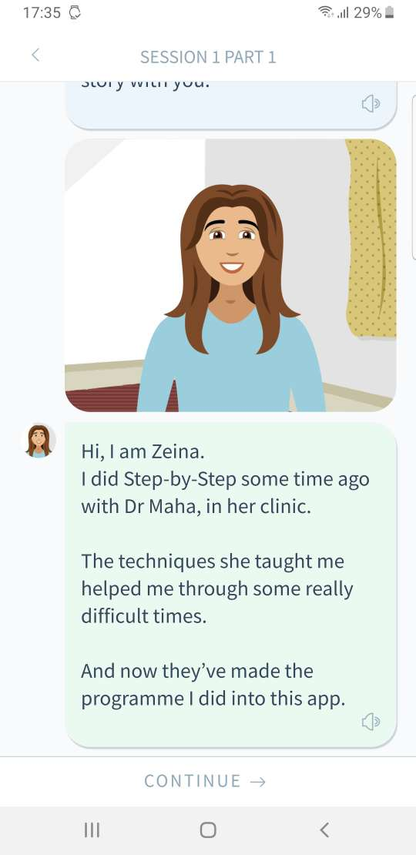
Conclusions
Messaging Apps are omnipresent:
Create familiar interfaces
(AAP)
(AAP)
(CTV)

Slide 20
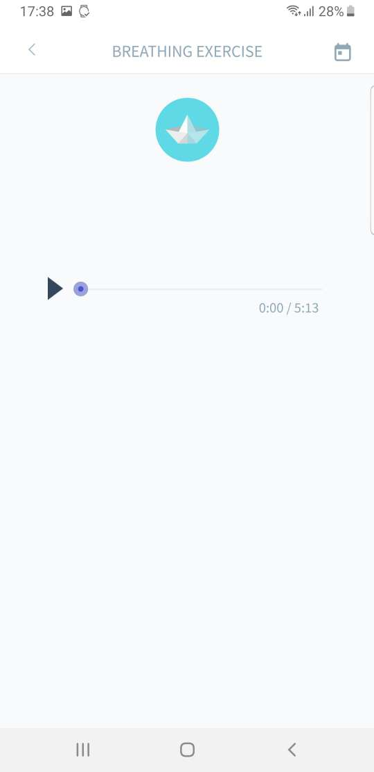
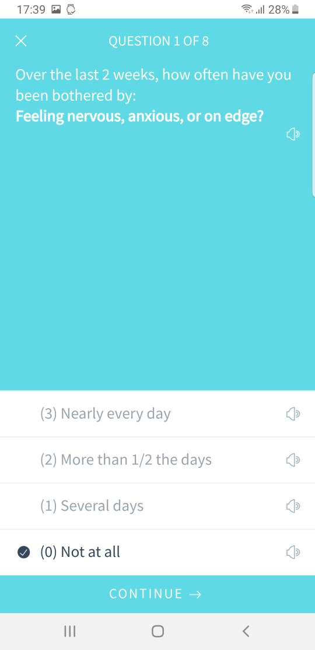
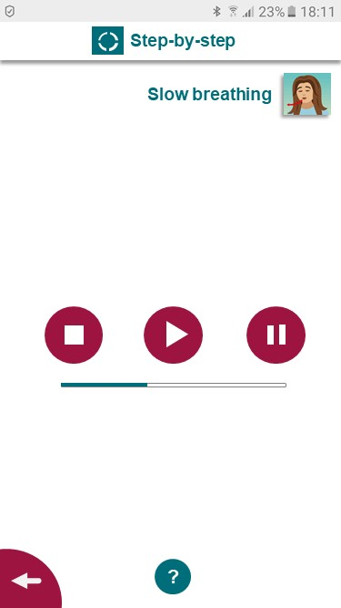
Conclusions
Stable access to the internet cannot be assumed.
Focus on offline capabilities
(AAP)
(AAP)
(CTV)

Slide 21
How did we get there?
Part 2: Key Informant Interviews and Focus groups
Notes:
We presented interactive prototypes (almost like a real app) to 36 Syrians (12 per country)
Gathered data on usability

Slide 22
Usability
Example 1: Usability dimension „Flexibility and customizability“
„The pictures are very useful and the idea of having many options and a girl with hijab and the other without is very nice.“ (Sweden)
„The idea to record and listen to audio is really nice, especially for older people.“ (Germany)
Positive comments: n = 19 (53%)
Negative comments: n = 4 (11%)
Notes:
Usability: The ease-of-use and learnability of the app. Or: How user friendly the app is. → Does it work as intended?

Slide 23
Usability
Example 2: Usability dimension „Learnability“
„There is no good orientation given.“ (Egypt)
„The next step is not clear.“ (Sweden)
Positive comments: n = 12 (33%)
Negative comments: n = 8 (22%)

Slide 24
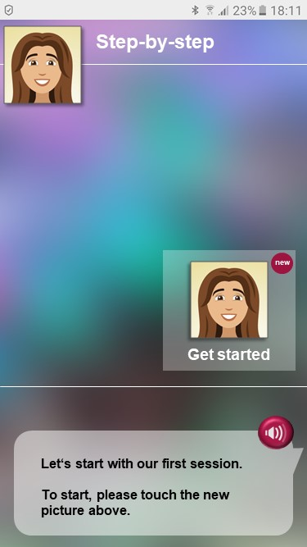
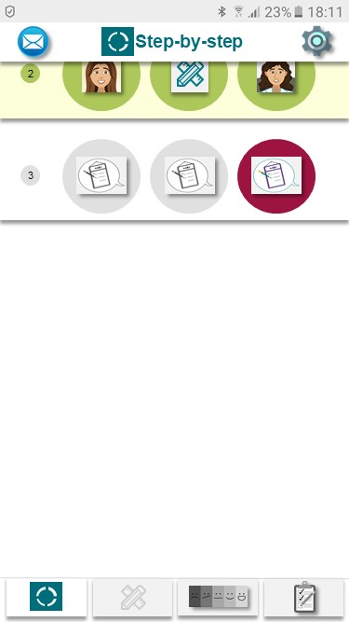
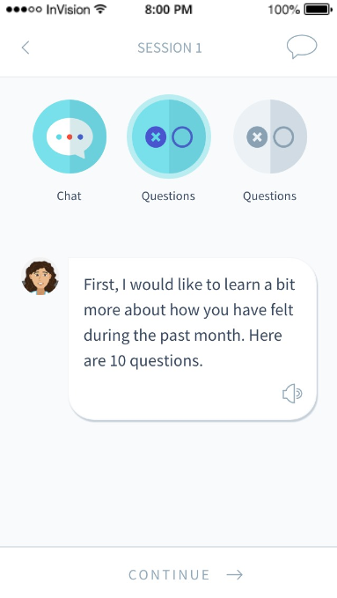
Conclusions
learnability
Version 1 Version 2 Version 3
Revise the User Interface
(AAP)
(AAP)
(CTV)

Slide 25
User Experience
Example 3: Usability dimensions „performance speed“
„The program must be faster. I mean there should be more sessions
every week, for example, a session every 3 days. “ (Germany)
Positive comments: n = 0 (0%)
Negative comments: n = 9 (25%)

Slide 26
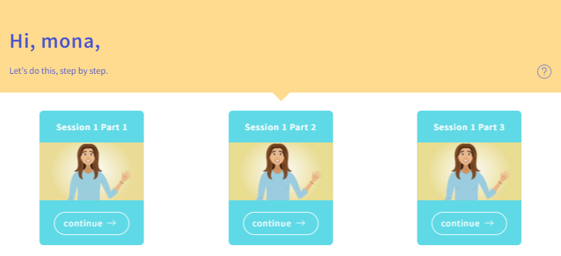
Conclusions
performance speed
Break sessions into shorter parts
(AAP)
(AAP)
(CTV)

Slide 27
Next steps …

Slide 28
Next steps …
IDEAS framework (Mummah et al., 2016)
Next:
Pilot study
RCT
Share

Slide 29
Software development
We build our software to be:
Accessible: iOS, Android and Web
Adaptable: Easy to change content or adjust the number of sessions
Reusable: Easy to create new versions (e.g. in other languages or with other exercises)
Open source: Will be available to the public
Secure: Strong focus on data protection

Slide 30
Thank you!
„Building an enjoyable app with good graphic design and satisfying interface is necessary for an effective intervention.“
Bakker et al. (2016)
“Mental Health Smartphone Apps: Review and Evidence-Based Recommendations for Future Developments”

