Slide 1
Group PM+ in Reducing Symptoms of Psychological Distress Among Syrian Refugees in Turkey: Feasibility Trial
Ceren Acartürk
İstanbul Şehir University
16th ESTSS conference 2019
Rotterdam, Netherlands , 14 June

Slide 2
SYRIAN REFUGEES IN TURKEY

Slide 3
Syrian refugees are exposed to various traumatic events during and after the war.
(Acarturk et al., 2018; Ben Farhat et al., 2018, Ibrahim & Hassan, 2017)
High risk for the development of mental health problems.
Depression: 14.5-44% (Fuhr et al., in press; Georgiadou et al.i 2018; Poole et al., 2018)
Anxiety: 13.5-92% (Fuhr et al., in press; Ben Farhat et al., 2018; Georgiadou et al., 2018)
PTSD :30% (Fuhr et al., in press; Alpak et al., 2014; Tinghög, et al., 2016)

Slide 4
STRENGTHS Field in Turkey
Istanbul
Sultanbeyli
The number of Syrians: 546.238
Lack of resources
Challenging demand on the mental health system of Turkey
Population: 327.798
The number of Syrians: 23.196
Refugee and Asylum Seekers Assistance and Solidarity Association (RASASA)
To evaluate the (cost-)effectiveness of the culturally adapted version of group Problem Management Plus (PM+) in Syrian refugees in Turkey with elevated levels of psychological distress.

Slide 5
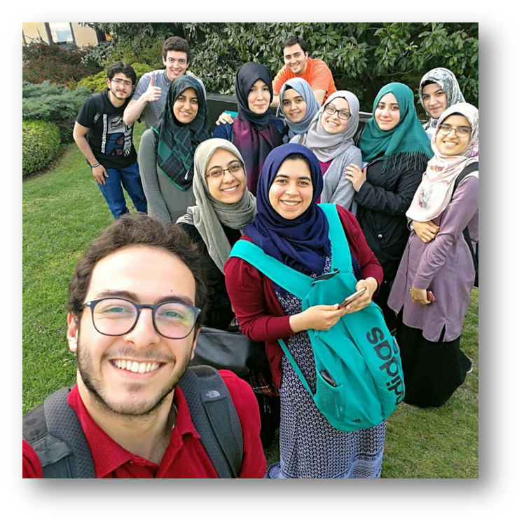
Phase 1: Adaptation of Group PM+ to Syrian Culture
Phase 1
Adaptation
Phase 2
Small, feasibility (RCT)
Phase 3
Process evaluation
Phase 4
Phase 5
Process evaluation
Large, definitive, RTC
ISU supported DRC, in the adaptation of PM+ to Syrian culture, through conducting Cognitive Interviews and Rapid Qualitative Assessments
24 Free Listing interviews
14 Key Informant Interviews with:
Syrian refugees
Mental health workers
Policy makers
2 Focus Groups

Slide 6
Results of RQA
The main problems identified by the Syrian refugees were as following:
Financial Problems; high living expenses, unfair of aid, problems with housing and living conditions.
Employment issues; unfair treatment, exploitation, lack of job opportunities.
Language and interactions with Turkish, social issues.
Syrian intergroup interaction; Social issues at home.
Lack of trust in the system; educational and health systems.
Problems do not exist independently but rather, they depend on each other
language
work
contact

Slide 7
Trainings in Turkey
Arabic speaking peers were trained to be the facilitators or assessors.
Getting referrals from RASASA
Advertisement through social media
Facebook
WhatsApp groups
Brochures
Short-movies
Recruitment Strategies

Slide 8
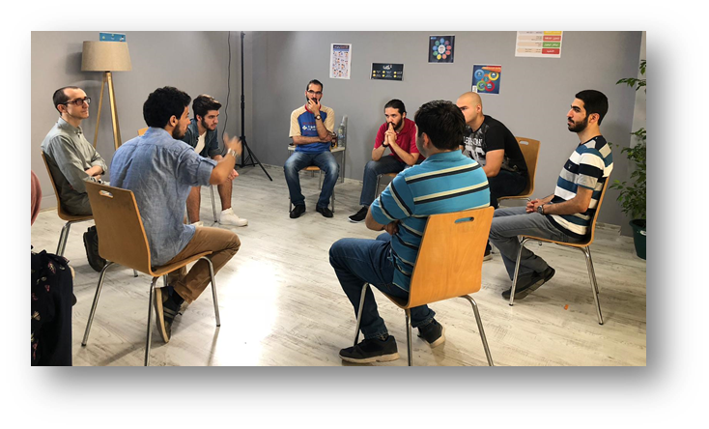
Screening and Baseline Assessments: September-January
78 participants screened
32 participants excluded
- WHODAS: 15
- K10: 4
- Thoughts of suicide: 4
- Mental capacity: 8
- The participants did not want to participate: 1
46 Participants included
22 E-CAU
24 Group PM+/E-CAU

Slide 9
Sample
 | PM+ | ECAU
Gender | % | %
Male | 33.3 | 31.8 | ns
Age M (SD) | 38.4 (8.9) | 27.5 (12.9) | ns
HSCL mean (95% CI) | 2.39 (2.23-2.56) | 2.36 (2.20-2.53) | ns

Slide 10
Primary Outcome Merasure: HSCL
Assessment Points | E-CAU mean (95% CI) | Group PM+ /E-CAU Mean (95%CI)
Baseline | 2.36 (2.20-2.53) | 2.39 (2.23-2.56)
Post-test | 2.34 (2.16-2.51) | 2.00 (1.83-2.17)
Follow-up | 2.18 (2.00-2.35) | 1.99 (1.80-2.17)
Time. F_{(1, 75)} = 15.63, p < .001, d = .19
Group F_{(1, 75)} = 1.14, p = .29 , d = .03
Interaction F_{(1, 75)} = 2.04, p = .16 , d = .21

Slide 11
Pilot Sessions: Attendance
Female Group 1 | 1st | 2nd | 3rd | 4th | 5th
Participant 1 | x |  | x | x | x
Participant 2 | x | x | x | x | x
Participant 3
Participant 4 | x | x | x | x | x
Participant 5 | x | x | x | x | x
Participant 6 | x | x |  | x | x
Participant 7 | x |  | x | x | x
Participant 8 | x | x |  | x | x
Female Group 2 | 1st | 2nd | 3rd | 4th | 5th
Participant 9 | x | x |  |  | x
Participant 10 | x | x | x | x | x
Participant 11 | x | x | x | x | x
Participant 12 | x |  |  | x | x
Participant 13
Participant 14 | x | x | x |  | x
Participant 15
Male Group 1 | 1st | 2nd | 3rd | 4th | 5th
Participant 16 | x | x | x | x | x
Participant 17 | x | x |  | x | x
Participant 18 |  | x | x
Participant 19 | x | x |  | x | x
Participant 20 | x | x | x | x | x
Participant 21 | x
Participant 22 | x
Participant 23 | x | x | x | x | x
No adverse event reported.

Slide 12
The Evaluation Phase - Feedbacks
Participants who completed the program
Learning how to divide the problems into smaller parts,
Being in a group and listening how other participants manage with their problems.
Participants who dropped out:
Dropped out because of personal reasons but started to use the breathing activity.
Most of the family members stated that they saw a positive change in their relatives after the sessions.

Slide 13
Challenges – Pilot Study
Low number of potential participants for screening
The reasons for dropping out from the first session were:
The day of the session.
Some of the female participants’ husbands did not give permission
One participant could not leave her disabled child
The reasons for missing the sessions were:
Being sick
Lack of motivation
Not getting an approval from the manager to leave work
Not being able to leave their kids

Slide 14
Discussion
PM + was not associated with any adverse events.
The drop out rates were as expected.
To recruit eligible participants we need to contact with more NGOs.
Sets the stage for a fully powered RCT.

Slide 15
Short Movie

Slide 16
Thank you…
E-mail: cerenacarturk@sehir.edu.tr

