Slide 1
IPIDUS SEQUAS ESTEREM QUA
Cultural adaptation of the Early Adolescent Skills for Emotions programme for use in Lebanon
Felicity Brown, Frederik Steen, Karine Taha, May Aoun, Mark Jordans
Occatur samus es et oditi quam fugia
16th ESTSS conference 2019
Rotterdam, Netherlands , 14 June

Slide 2
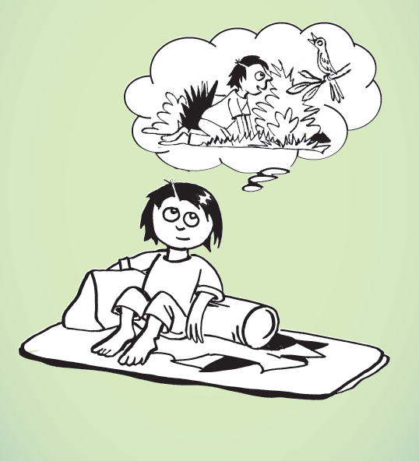
Early Adolescent Skills for Emotions (EASE)
Group psychological help for young adolescents impaired by distress in communities exposed to adversity
Who is it for?
- 10-14 year olds, transdiagnostic (stress, depression, anxiety)
What is it?
- Problem-solving, identifying feelings, stress management, behavioural activation, strengthening social supports
How is it delivered?
- 7 sessions group format plus 3 sessions for caregivers
Notes:
Felicity

Slide 3
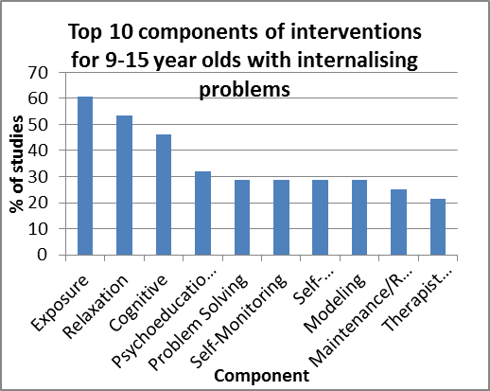
Development of EASE
Notes:
Felicity

Slide 4
Planned Trials
Lebanon
Jordan
Tanzania
Pakistan
Notes:
Felicity

Slide 5
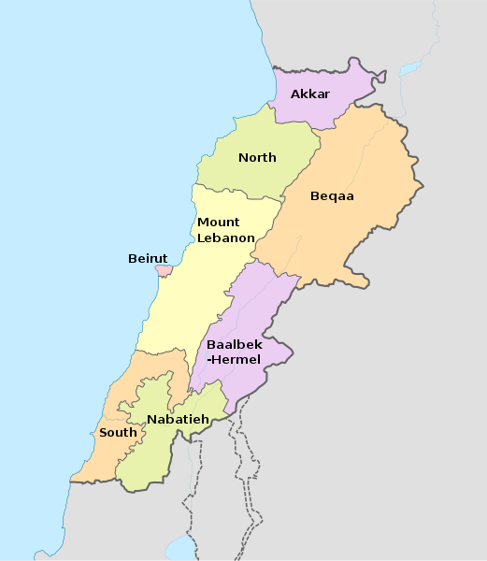
EASE in Lebanon
Lebanon
Middle Income Country
Population 6m
1.5m Syrian refugees
>200,000 Palestinian refugees
Many vulnerable Lebanese children
Syrian, Lebanese, Palestinian children
Conducted through War Child Holland
Locations-
Vulnerable regions in North and Akkar
Very few publicly available MH services, especially for children
Facilitators-
Experienced, non-specialist psychosocial support providers
Notes:
Felicity

Slide 6
WHO’s 5 Phase Evaluation Model
Phase 1
Adaptation of intervention for local sociocultural context
Phase 2
Small, feasibility randomized controlled trial (RCT) (feasibility, safety, trial procedures)
Phase 3
Process evaluation to prepare for scaling up
Phase 4
Phase 5
Process evaluation to prepare for RCT
Large RCT to evaluate
Notes:
Felicity

Slide 7
Introduction to Adaptation
Changing programme and training materials to fit a particular set of circumstances
Balance between maintaining fidelity versus cultural and contextual ‘fit’
Recommended that core components maintained, while minor changes can be made to improve: acceptability, comprehensibility, relevance, and accessibility/feasibility
Examples of minor changes:
Illustrations
Examples
Stories
Terminology/ inclusion of local idioms
Notes:
Adaptation is the process of deciding on and producing the changes needed in the programme and training materials to fit a particular set of circumstances

Slide 8
Why adapt?
Evidence that culturally-adapted interventions more effective (SMD= 0.72; Chowdary et al 2014)
Treatment effects increase with increased number of adaptations made (Harper Shehadeh et al., 2016)
But often adaptations not done systematically, or not documented.
No clear consensus on HOW to do this
WCH is currently field-testing a systematic way to implement adaptations and document them
Notes:
Chowdhary N, Jotheeswaran AT, Nadkarni A, et al. The methods and outcomes of cultural adaptations of psychological treatments for depressive disorders: A systematic review. Psychol. Med. 2014;44(6):1131

Slide 9
Adaptation Process
Desk Review
Rapid Qualitative Assessment
Cognitive Interviewing
Psychologist Read Through
Mock Sessions
Adaptation Workshop
Revision of Materials

Slide 10
Occatur samus es et oditi quam fugia
1. Rapid Qualitative Assessment & Desk Review

Slide 11
Aims
Understanding of problems experienced by community
Give insight on how these experiences are expressed locally.
Explore individual and community coping methods are commonly used by the adolescents.
Explore the awareness and communication around Mental Health in the wider community.
Map the services around MH already available in the community
To receive input on the planned EASE intervention delivery
Notes:
Wide spread of goals.
First three are all relevant to come up with culturally appropriate examples in the intervention).
Point 4 and 5 This information is used to make sure we link to the awareness of the local communites in our materials, but also implementation period
Point 6 to create functioning scale
Last point for how we will do the implementation. To validate and adapt measures of psychological functioning and wellbeing to the local context.

Slide 12
Methodology
Free listing
11 children, 13 caregivers
Focus Group Discussion
15 children
Key Informant Interviews
7 children
9 caregivers
4 community members
3 health care providers
Notes:
In total 24 FL
23 KIIs
4 FGDs of total 15 children
Lebanese 31
Syrian 29
Palestinian 1
Lebanese/syrian 1
When: May 2017
Where: two communities in North Lebanon, via community based organisations working with War Child Holland
Methods:
Free Listing Interviews (FL) to identify key problems in the community, and ideas around daily positive functioning
Focus Group Discussions(FGDs) and Key informant Interviews (KIIs) to explore problems further.
Children, Parents, Community Members, and Mental Health Care Providers.
No specific inclusion criteria.

Slide 13
Results- Free Listing
What activities does a well-functioning adolescent do?
Helping caregivers and other family members
Showing respect and affection to important adults
Spending nice/pleasurable time with siblings and other family members
Praying or other religious activities
Eating and enjoying food
Taking care of personal hygiene
Playing with friends
Entertaining self with games / individual sports
Studying for school
What problems affect adolescents?
Physical violence and abuse
among children
from adults towards children
Neglect and emotional abuse from parents
Emotional abuse among children
Catcalling and bullying among children
Children using bad language with each other
Substance use by children
Notes:
During the week of data collection the first two days were spent on Free Listing. These interviews were build up from three parts and had the purpose to inform the Focus Group Discussion and the Key Informant Interviews. The three elements were:
Problems that affect adolescents in Hay El Tanak and Beb El Tebeneh. Caregivers and children were asked the following question: What are all the problems that affect children and adolescents in this community? I want you first to list them all and then I will come back to ask for a description”. For the results see section 5.
The second question was about who we could ask more about this in the KIIs: “Who in this community can tell us more about these problems?” Followed by: “who in this community do adolescents consult when they have these problems?”.
No answers on this question had been provided, either because the participants could not think of anyone to recommend, or the Research Assistants (RAs) did not ask for it. This meant that we have done the recruitment of the participants for the FGD and KIIs, completely separate from the Free Lists interviews.
The third questions were about the functioning of children, which will inform a measurement instrument that will be used during the pilot and definitive RCT of the EASE intervention (see also section 6.6). The questions asked to parents were different for children and parents.
To children we asked:
What does a child who is doing well look like in this community? (including emotions, behaviours and actions)
What activities do boys/girls typically do in this community?
To parents we asked:
What are the activities that children and adolescents of this community do frequently to care for themselves?
What are the activities that children and adolescents of this community do frequently to care for their family and/or caregivers?
What are the activities that children and adolescents of this community do frequently to care for their community?

Slide 14
Results- Framework Analysis
Emotional abuse, Bullying and Physical Violence
Substance use
Poverty
Other problems
Community awareness of MH and coping mechanisms.
Service Mapping
Input on intervention Implementation

Slide 15
1: Emotional Abuse, Bullying and Physical Violence
Common
Violence is perceived as the ‘norm’
In home
Teachers at school
Between children
Causes: poor parenting, poverty, conflict between ethnic groups
Also appears in other literature
Notes:
- Its presence of was immense across all participant groups, and appears to be prevalent in all strata of society.
- Several references that violence is perceived as the ‘norm’ and both its origin and impact were heavily felt, experienced and witnessed by all participants.
- Frequently used as a disciplinary tool both in the home and at school and also children against other children
Sexual abuse amongst children – not specifically asked for.
Amongst adolescents the use of bad language and emotional and physical violence was regularly attributed to poor parenting.
Poverty was frequently cited as a reason why these problems existed in families and often a reason that impacted the community

Slide 16
2. Substance use
Highly prevalent: drinking, pill taking and smoking
Limited understanding about the physical and psychological impact of substance use
Causes: boredom, lack of opportunities, poverty, parenting influences mentioned as underlying causes of substance use
Effects: increase in violence, isolated from family members
Also appears in other literature- needs to be addressed

Slide 17
3. Poverty
Major daily stressor
Poverty and lack of education are cyclical: children drop out of school to work and provide for the family
Families unable to provide essentials such as housing, clothing, food etc.
impact: Connection between poverty and criminal activity
Also appears in other literature

Slide 18
4. Other Problems
Tensions between Lebanese and Syrians
Syrians feel discrimination
Lebanese respondents not happy with the Syrian ‘newcomers’
Stigmatisation: experienced based on ethnicity, poverty and Mental Health problems
Little referral to traumatic events in conflict – separation from beloved ones
Daily Stressors - emphasised in other literature

Slide 19
5. Community Awareness of MH and coping mechanisms
Coping mechanisms
Negative: substance use, violence, normalisation of abuse etc.
Positive: talking with friends and parents (especially mother), seeking assistance, role of good parenting, playing/doing activities, friendships
Mental health awareness
Varied level of awareness. Some linked problems to mental health.
Varying opinion on seeking assistance and on benefits MH interventions, taboo.
Notes:
Could have been asked more for by the Ras

Slide 20
6. Service Mapping
MH professionals have knowledge on what is available.
Majority community members not aware of many MH services
Suspicion of work of NGOs – quality and fairness (impact on implementation) – It’s better talk to friends and family

Slide 21
7. Input on Intervention
EASE helper
Should come from the region
Should be well trained and have a relevant background (MH professionals).
Parents: Role of parents is crucial - participation of the adolescents depend on the willingness of the parents.
Location of EASE: a house, park, the stadium, or centers.
Time for EASE: Almost all participants recommend a time outside school hours.

Slide 22
Occatur samus es et oditi quam fugia
2. Cognitive Interviewing

Slide 23
Aims
Ensure that the intervention materials are easily and accurately understood by participants.
Ensure that the content of interventions is culturally acceptable and is relevant to the target population.
Methods
2 groups of children and 2 groups of caregivers were shown the materials and asked questions about whether it was relevant, understandable, acceptable.

Slide 24
Main Findings
Storybook and EASE manual sessions were relevant, comprehensible
Language used was simple and easy to understand
Children:
Report problems of parents fighting with neighbours, rather than own life
Some explanation needed of strategies
Caregivers:
Very talkative, liked the chance to share with others
Worried that suicide would be discussed with children
Physical punishment very common and openly disclosed- many parents state no other options
Recognised need for self-care but hard to implement

Slide 25
Occatur samus es et oditi quam fugia
3. Psychologist Read-Through

Slide 26
Aim
Check for consistency, accuracy and appropriateness of Arabic wording and idioms
Methods
3 PSS trainers, Regional PSS advisor, and research coordinator read through materials and discussed any translation issues

Slide 27
Main findings
Language generally understandable
Revisions were made for consistency, accuracy, and simple terminology
e.g.
“emotional problems” – word used in Arabic, while accurate, can have connotations of “romantic problems”
“3attifieh” → “naafsieh”

Slide 28
Occatur samus es et oditi quam fugia
4. Mock Sessions

Slide 29
Methods
Attendees:
3 x WCH PSS trainers from Lebanon
WCH Regional PSS advisor from Middle East Region
3 x non-Lebanese psychologists
2 x non-Lebanese researchers
Process
The 10 sessions were presented to the group by a psychologist
An overview of the session was given, and material was walked through
Key activities were conducted as in manual, others were read through
Feedback was gathered on issues and suggested changes

Slide 30
Several suggestions were made on:
Relevance
Understandability
Acceptability
Specific suggested changes

Slide 31
Adaptation Process
Desk Review
Rapid Qualitative Assessment
Cognitive Interviewing
Psychologist Read Through
Mock Sessions
Adaptation Workshop
Revision of Materials

Slide 32
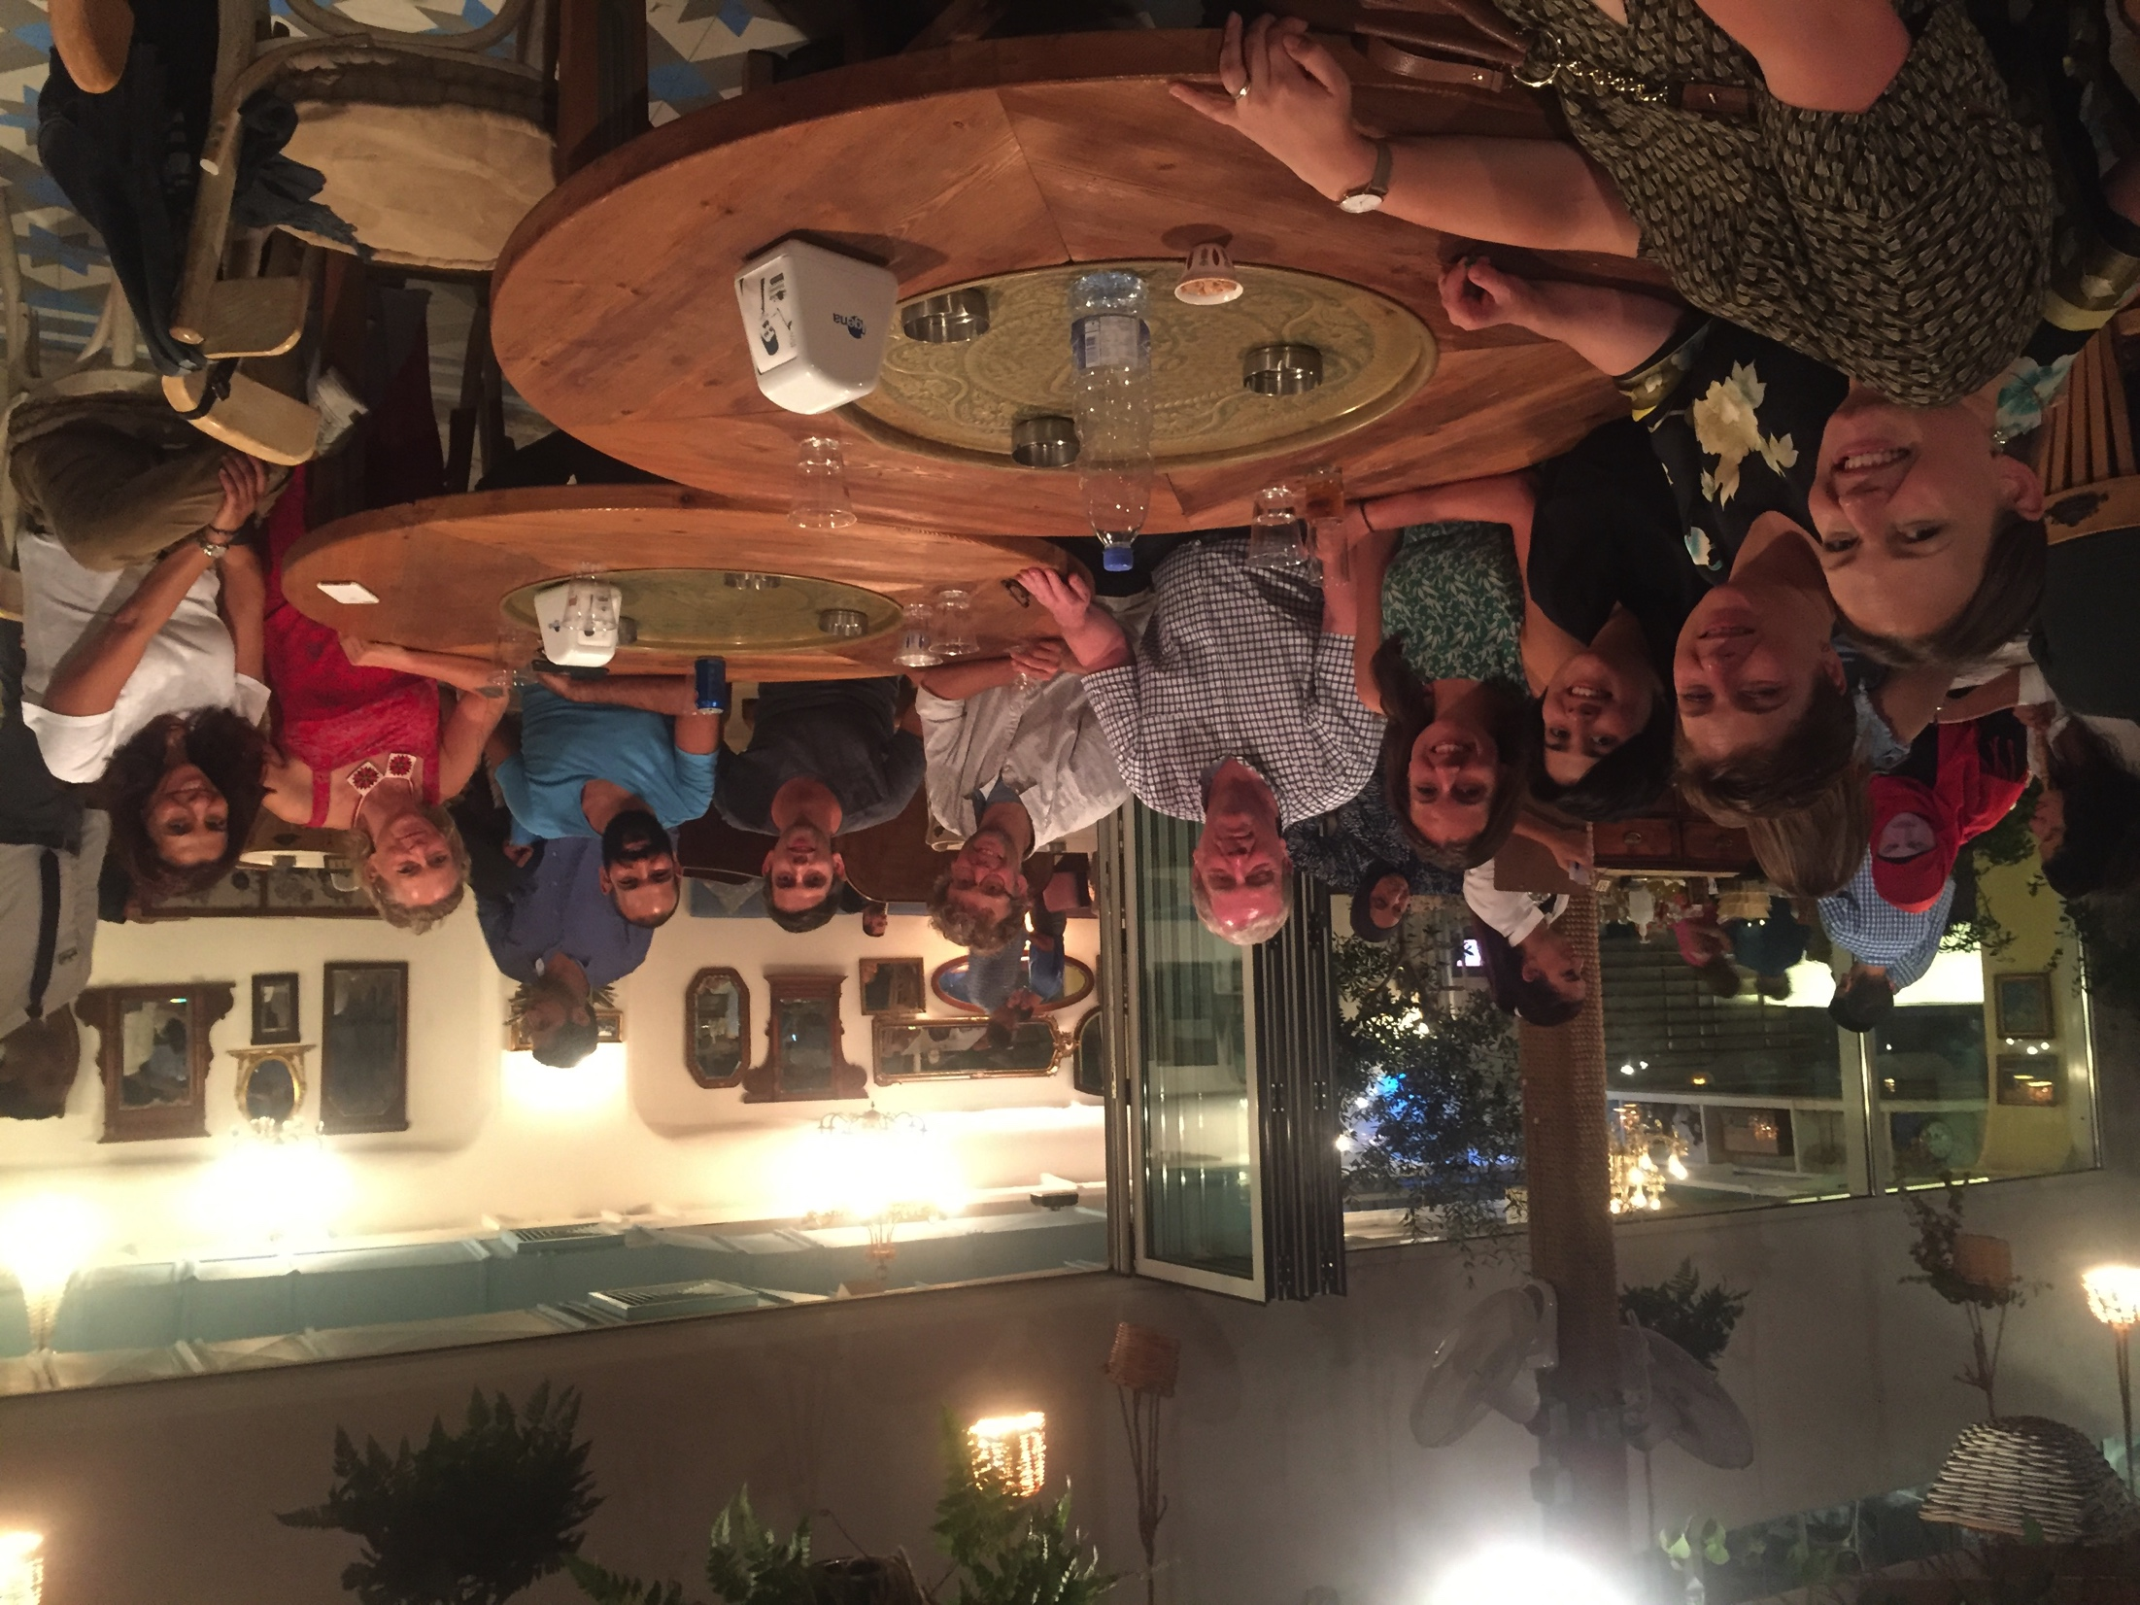
ADAPTATION WORKSHOP!

Slide 33
→ Many suggestions were incorporated in WHO ‘base’ manual as relevant to all low resource contexts

Slide 34
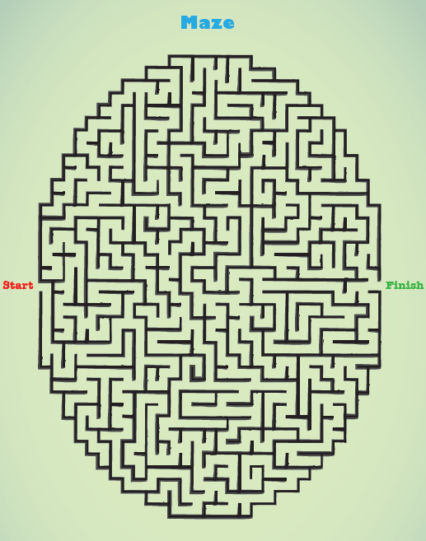
Example – Maze activity added
Solving a problem is like finding our way through a maze. We have to try lots of different routes to get to the end. We might try one route but find that it goes to a dead end. So we have to go back and try another way. Sometimes the problem is very hard – just like this maze- so we try our best to reach the end, and sometimes we need to ask for help to do this. Although we may not reach it quickly, we have made a lot of progress since leaving the start.
So when we try to solve our problems, we sometimes have to try lots of solutions before finding one that helps manage the problem. Sometimes solving our problems can take a long time- but each route we try brings us closer to the solving the problem.
Notes:
Was “wise person trying to gather clues”

Slide 35
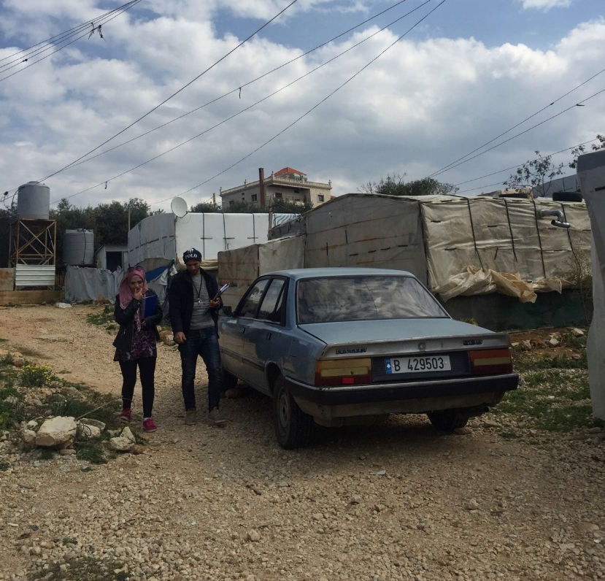
Adaptations for Lebanon – Pre-Piloting
Addressing aggression and bullying throughout
Tired cycle → Vicious Cycle
Took out story about mother’s death
Training for facilitators for how to respond to (but not directly treat) disclosure on Grief, Abuse, and Substance Use
Reducing resources needed- such as balloons, coloured pencils, costumes
Prioritising problems during problem solving
Changed reference to “doctors” and “scientists” —> trusted neighbours and lived experiences instead
Quality time needs to consider large families, limited space, and limited time

Slide 36
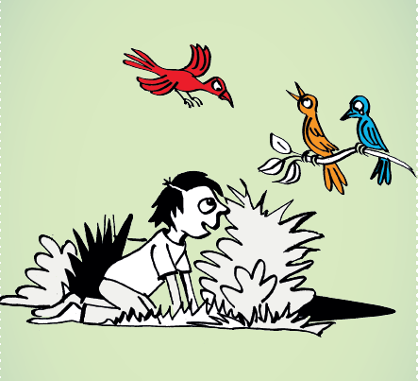
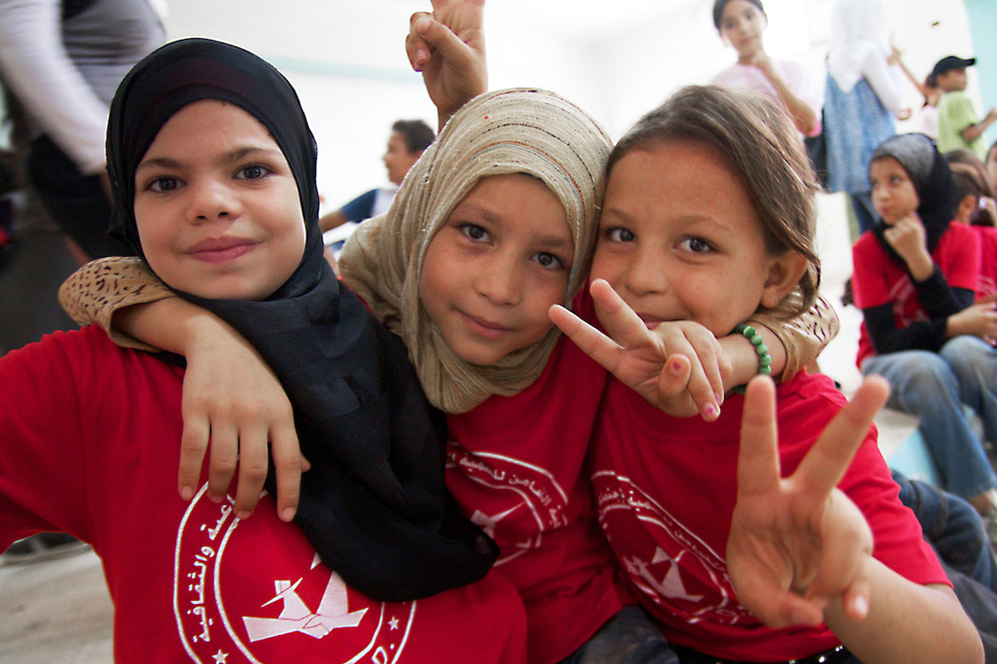
Adaptations– post-piloting
More interaction was incorporated into sessions
Storybook was re-written by a creative writer to increase engagement and interest
Caregiver sessions shortened due to low literacy and need for slower pace

Slide 37
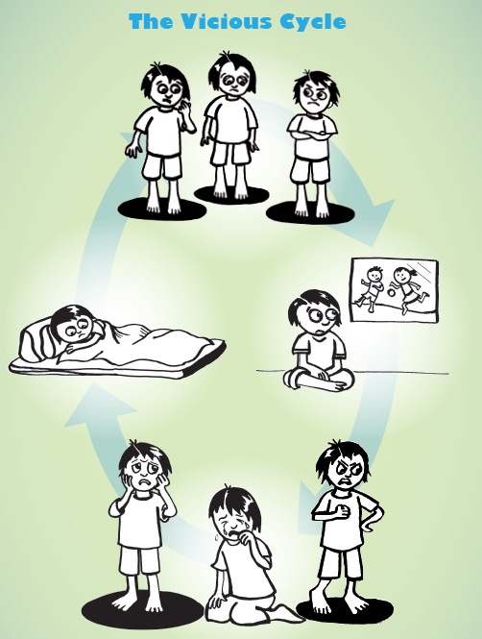
Example – Tired Cycle → Vicious Cycle

Slide 38
Next steps…..
Phase 1
Adaptation of intervention for local sociocultural context
Phase 2
Small, feasibility randomized controlled trial (RCT) (feasibility, safety, trial procedures)
Phase 3
Process evaluation to prepare for scaling up
Phase 4
Phase 5
Process evaluation to prepare for RCT
Large RCT to evaluate
Notes:
Felicity

Slide 39
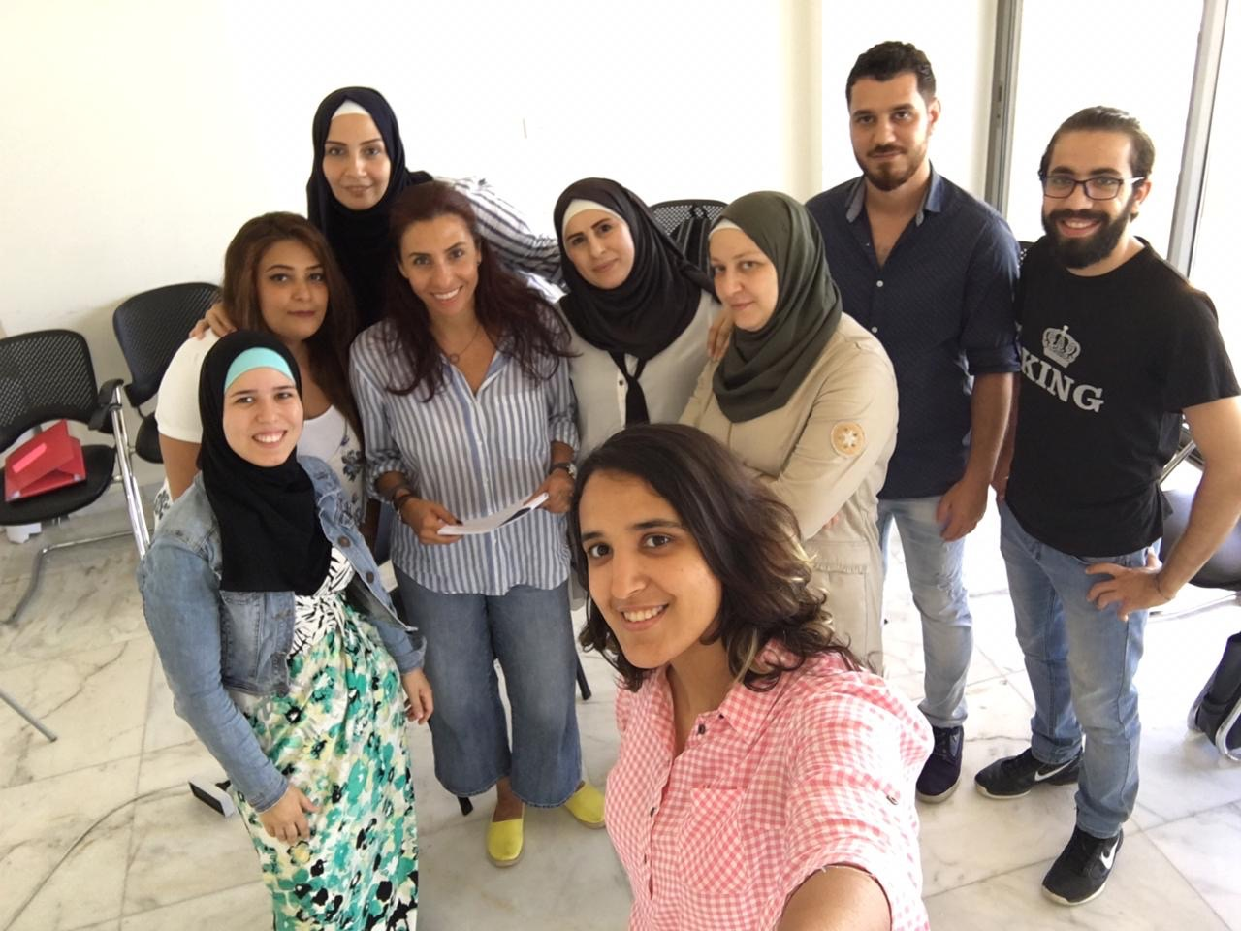
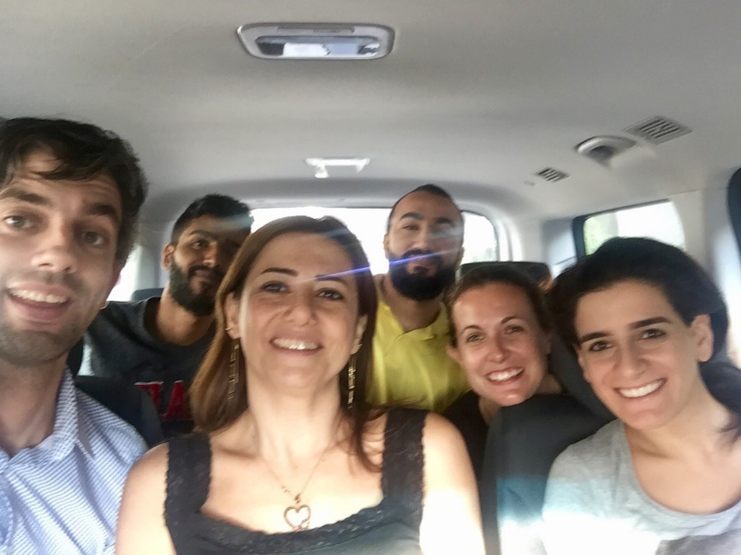
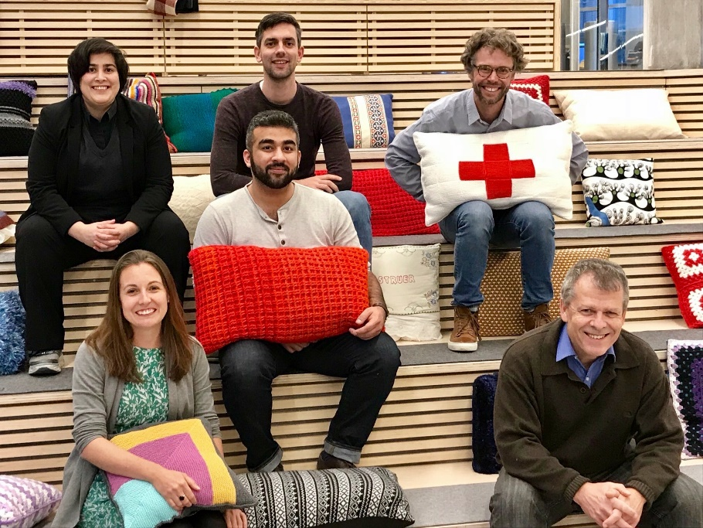
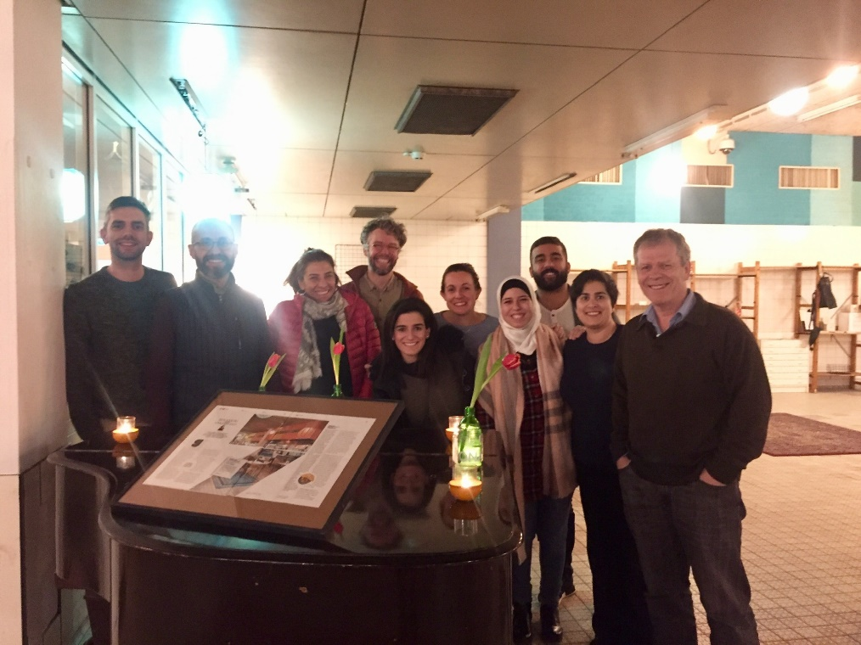
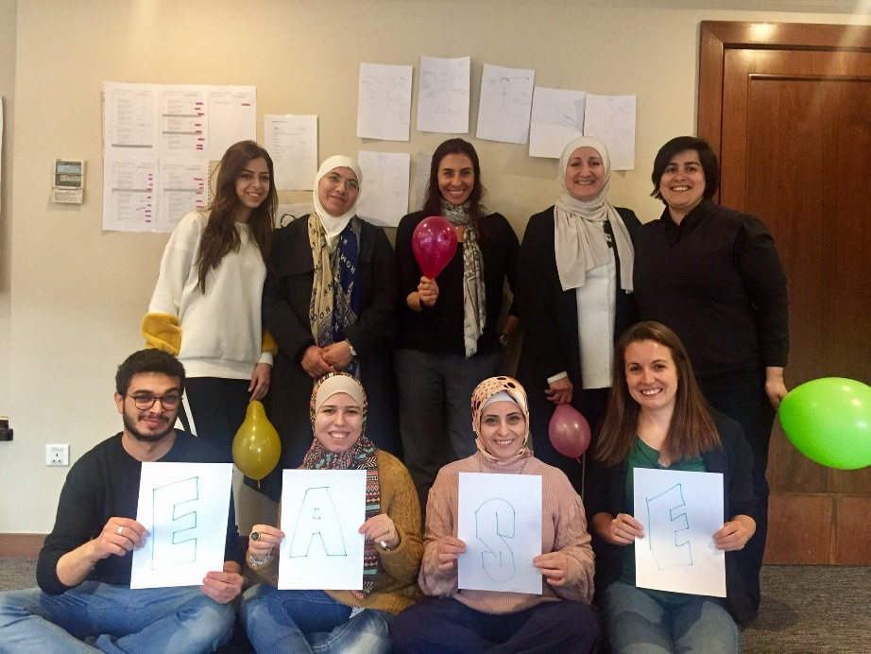
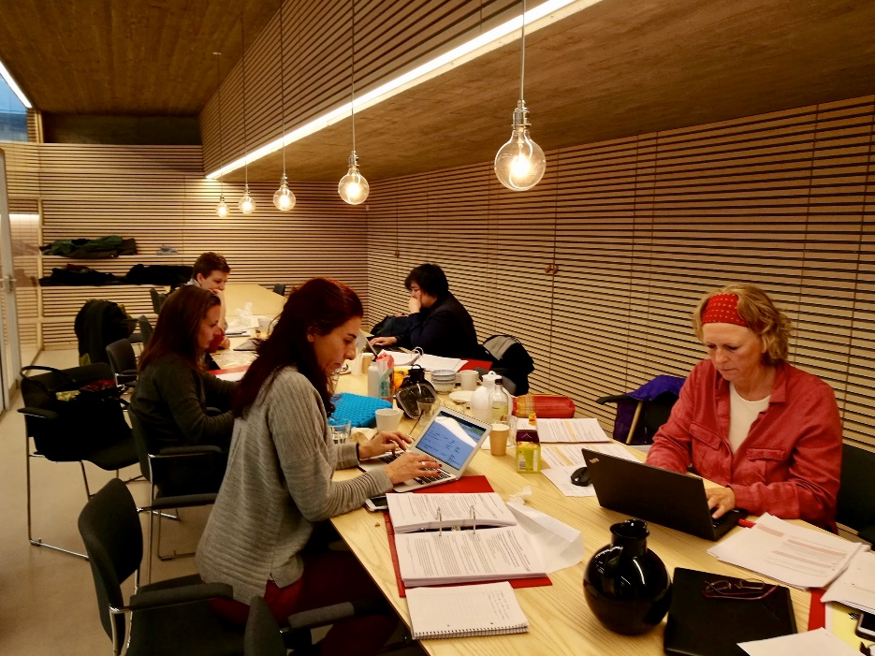
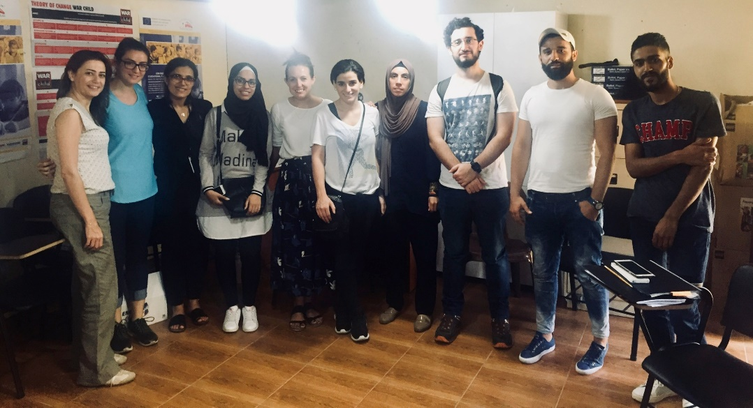
It’s been a huge, fun, team effort!

Slide 40
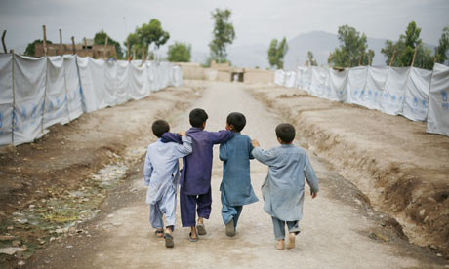
Thankyou!
felicity.brown@warchild.nl

