Slide 1
Consortium annual meeting 2019
WP8 Dissemination and Communication
Peter Ventevogel (UNHCR)
Sadaf Kaykha, Trudy Mooren (WTF)
Louise Hansen (DRC)

Slide 2
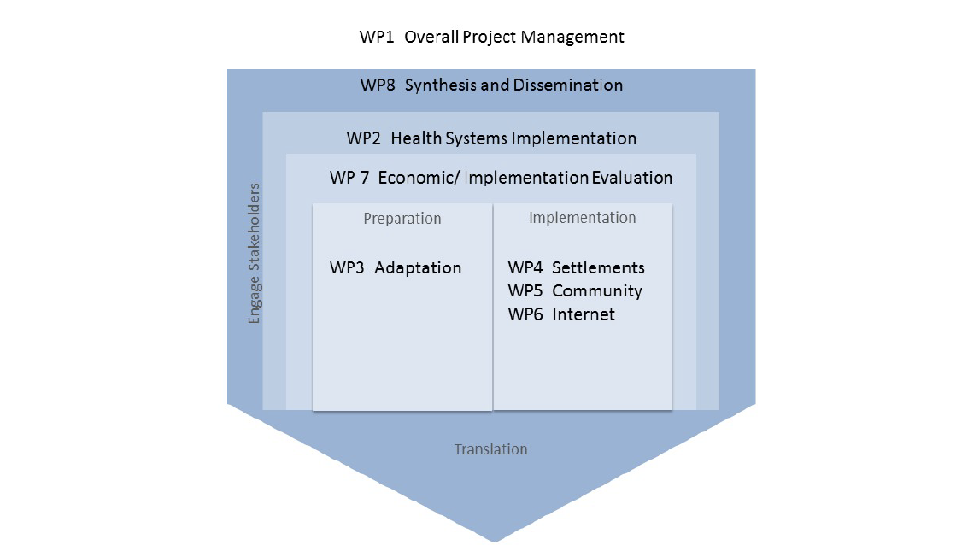
Aims of work package 8?
Identify and engage new organisations and individuals to support scaling up
Assess needs and requirements for successful scale up
Dissemination of research results
promote buy-in of framework for larger scale implementation

Slide 3
Who is in work package 8?
UNHCR
War Trauma Foundation
DRC
With: IMC, MOH Lebanon, VUA

Slide 4
Milestones and deliverables
Deliverables
Website (http://strengths-project.eu)
Dis com plan
Milestones
Training network (take over from WP3)
Identification of new stakeholders

Slide 5
Purpose of communication and dissemination
Specific objectives:
inform various stakeholders about STRENGTHS and engage them,
promote use of the developed methods and tools,
facilitate early adoption of PM+ programmes by new users,
facilitate a sustainable STRENGTHS training network beyond the duration of the project.

Slide 6
Dissemination target group
The ‘internal’ audience:
The 15 partners in STRENGTHS,
Related third parties (such as WHO),
The Project Advisory Board and the Safety Board.
The ‘external’ audience:
Policy makers and programme designers
Researchers
MHPSS professionals / PM+ deliverers
Syrian refugees

Slide 7
Internal communication and dissemination
Group mails → Every first Thursday of the month / FGB STRENGTHS
Website login section (finalised material)
Periodic Meetings
Reports
Communication toolbox

Slide 8
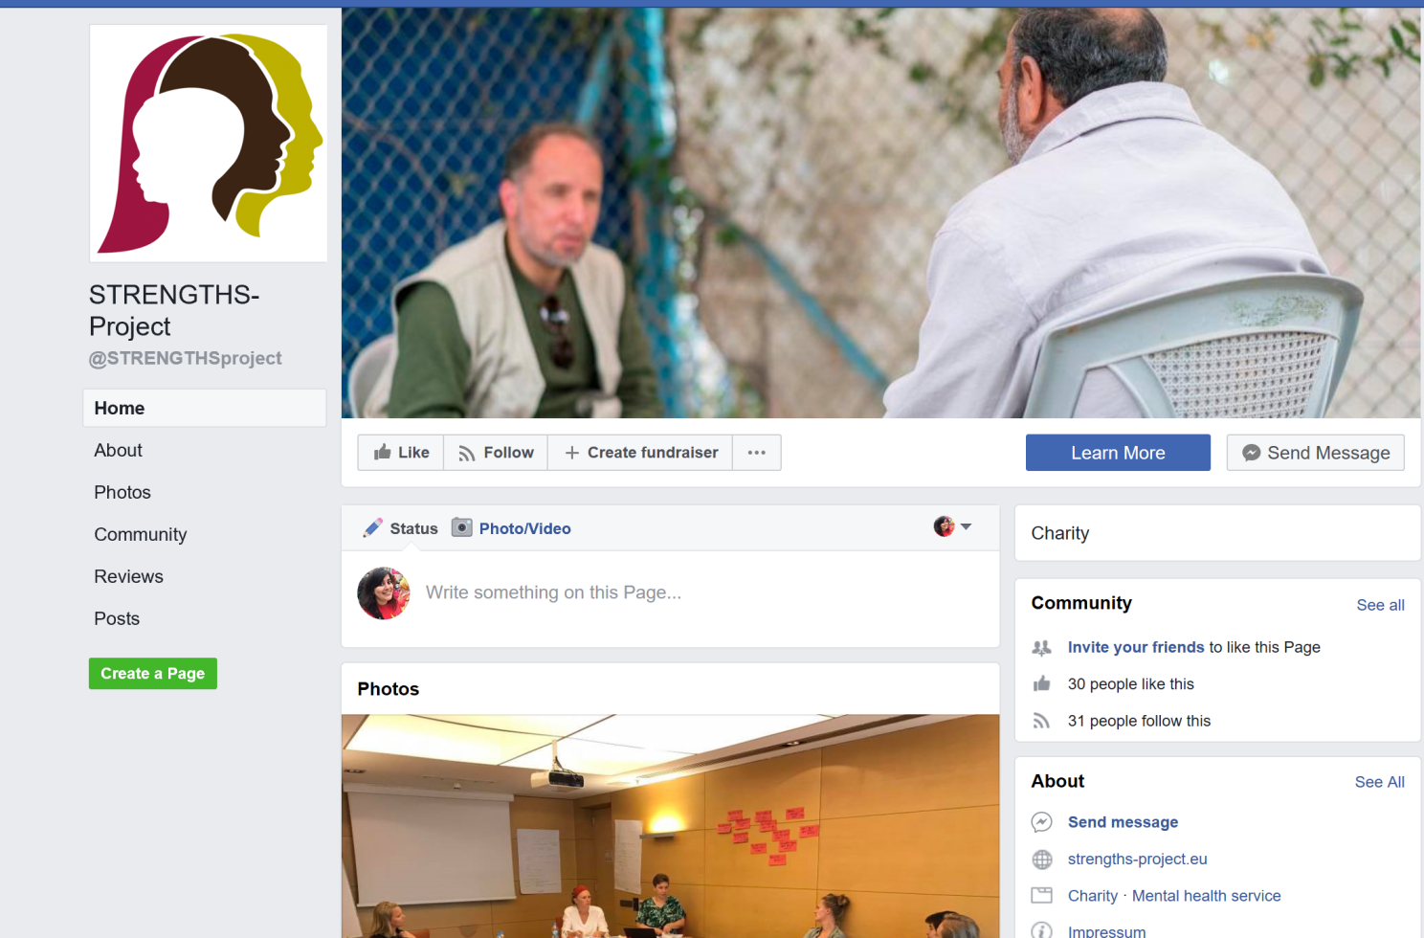
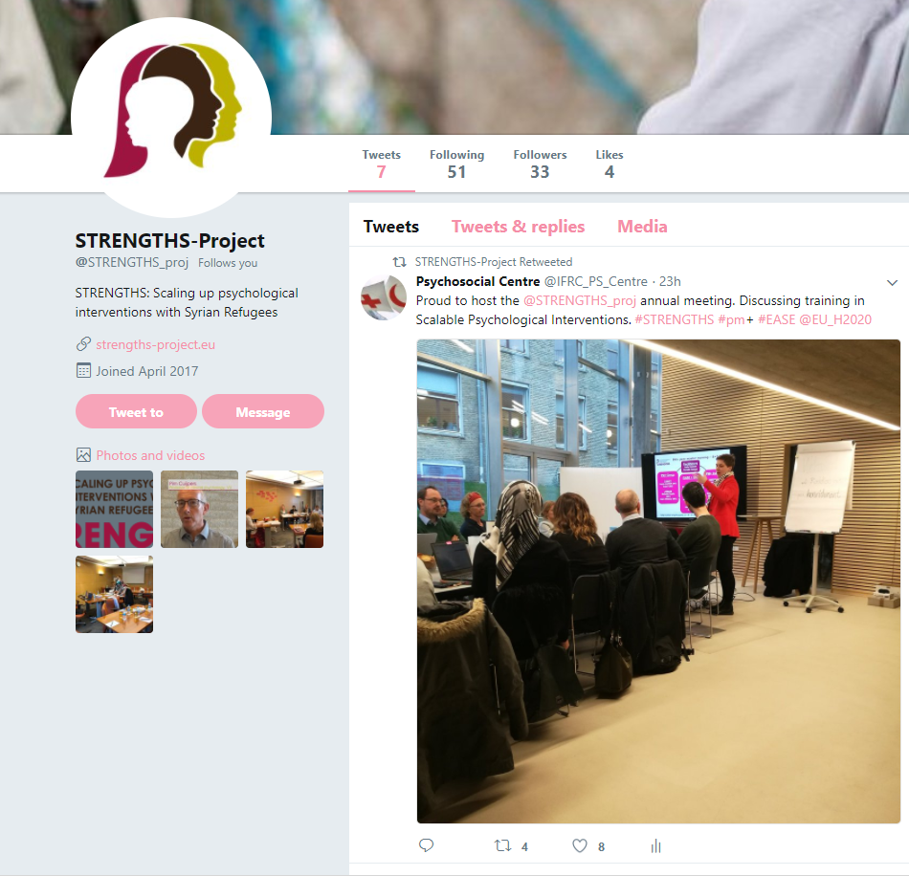
External communication and dissemination
Social media
Twitter: @STRENGTHS_proj
Facebook: STRENGTHSproject
Newsletter/ website
Presentations at academic conferences, training seminars, courses, workshops, webinars
Publication in scientific journals
Blogs and podcasts
Publications in general press / radio /tv interview
→ DISSEMINATION LOG

Slide 9
Toolbox for dissemination available on dashboard of website
Logo
Branding guidelines
Portfolio of pictures (more needed)
Templates

Slide 10
Realisations 2018
2 Newsletters per year
Website login section with content now operational (!!!)
Updated dissemination log including needs of WP7
Individual video and written interviews
Two stakeholder engagement events (Istanbul and Amman)
Articles in newspapers and journals

Slide 12
Newsletter
38 recipients , 66% open rate
149 recipients, 53% open rate
221 recipients, 54% open rate

Slide 14
Actions for 2019
Updated dissemination plan (June 2019)
Animation movie for promotional purposes
Newsletters
Start working on Advocacy package and implementation support package
Stakeholder engagement meetings
Set up of training network

Slide 15
Tools for dissemination to be created
Communication & Dissemination package
Standard PowerPoint presentation
Flyers/ brochures, factsheets
Press pack
Implementation support package
Advocacy package for policy makers

Slide 16
Discussion points: What are your ideas about:
Stakeholder engagement: joint meetings for TOC around scaling up?
Where? When How?
Training network
Platform for people in/out STRENGTHS to share experiences/ resources
Demonstration videos (how to train? How to supervise?)
Stakeholderlist (?)
Dissemination and implementation logs
How can we assist in completing?
Regular calls (WP7/8)
Factsheets to be developed?
Adaption?

