Slide 1
WP3 and WP6 Online and App Version
Sebastian Burchert & Christine Knaevelsrud

Slide 2
Work Package 6
Online Implementation
“This work package will implement the evidence based PM+ programme by creating an online and offline computer and smartphone based version for Syrian refugees.”

Slide 3
Work Package 3
Adaptation
Task 3.2 “Adaptation of ePM+”
“The pre-existing WHO concept for electronic PM+ will be further adapted and a culturally adapted contact-on-demand functionality will be developed.”

Slide 4
Activities in WP3
Desk-research and consultation
use of information and communications technologies (ICTs) among Syrian refugees: smartphones as main access point
existing WHO online intervention: “Step-by-step”
need to focus on smartphone adaptation of Step-by-step
there will also be a classical online version
identification of mHealth adaptation frameworks

Slide 5
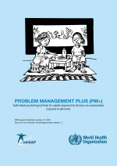
Step-by-step
Managing stress
Behavioral activation
Strengthening social support
Staying well
Less focus on the steps of Problem Management
More activity focused problem solving
Positive self-verbalization (“be kind to yourself”)

Slide 6
Step-by-step
General features

Slide 7
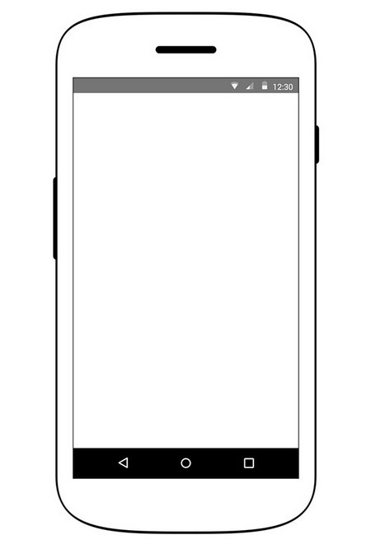
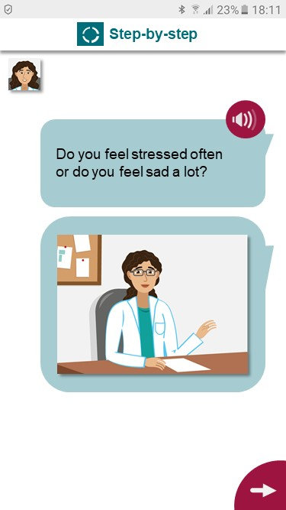
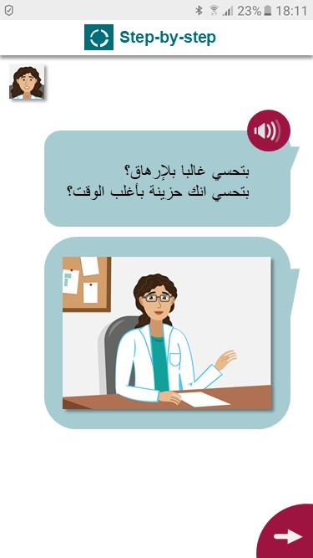
Arabic and English language versions
i
Language can be chosen in the options section of the app.
Levantine Arabic and English versions are the basis for potential future language versions.
Texts are written in spoken language, not in formal Arabic.
Levantine Arabic (spoken)
English

Slide 8
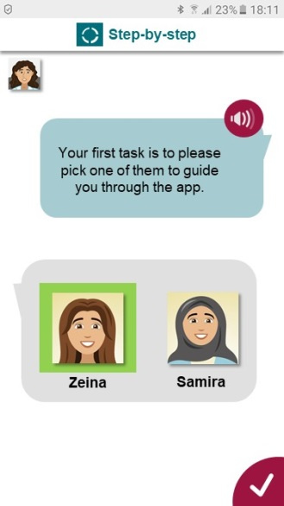
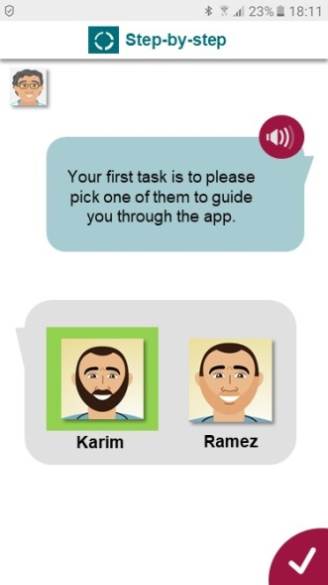
Chose one of four different narrators
i
This is intended to provide a certain level of customization.
Users can choose a protagonist that is similar to them.
2 male and 2 female, with a different style of clothing
Narrators guide through the intervention
They are introduced as previous patients who talk about their own experiences with the program

Slide 9
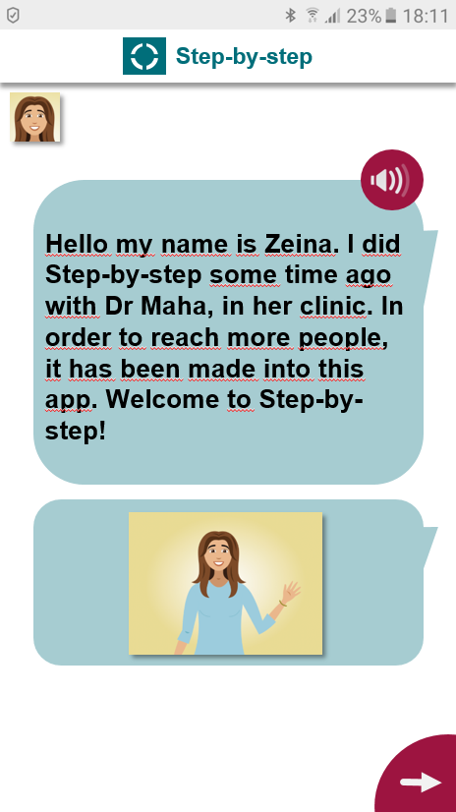
Illustrated narratives
i
No walls of text.
Illustrations that are (to a high degree) culturally neutral and easily adaptable.
protagonist
Dr. character

Slide 10
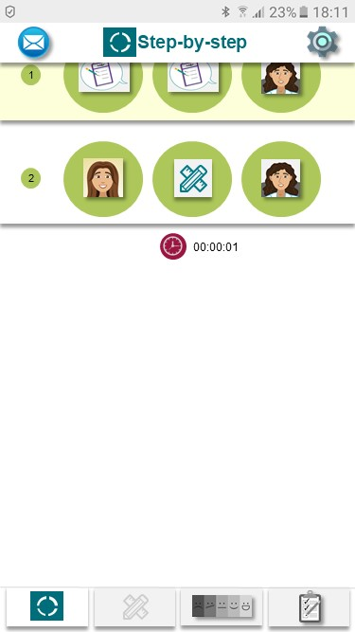
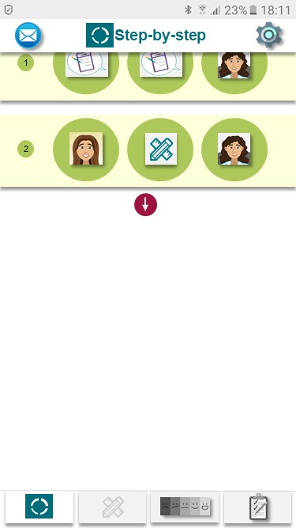
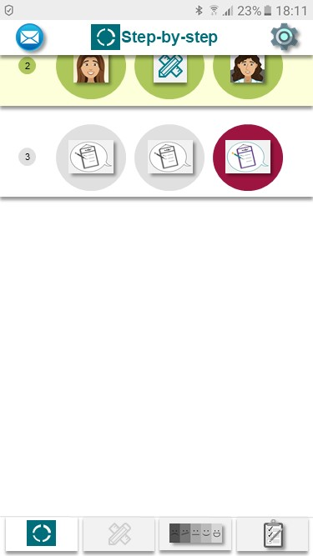
Sessions
i
Sessions structure the intervention and leave time to practice new skills.
There are 5 major sessions
Sessions are separated into steps
All sessions combined take 5 weeks to complete
All sessions and steps can be repeated

Slide 11
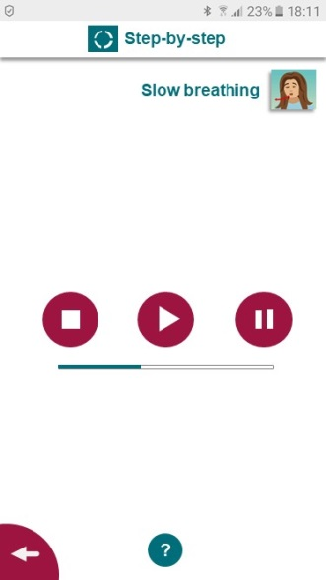
“Slow breathing”
i
Managing the physical symptoms of stress and anxiety:
Breathing quickens,
takes place in the chest and
becomes shallower.
Results can be:
headaches
chest pain
tiredness
dizziness
Slow breathing actively counters these effects.
Relaxation technique that works with a pre-recorded audio guide.
Teaches to focus on breathing and to slow down breathing to reach a relaxed state of body and mind.

Slide 12
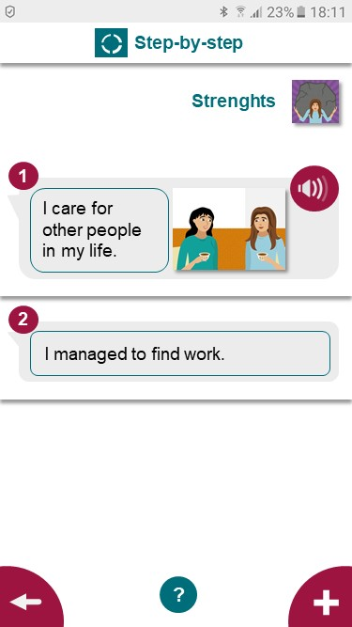
“My strength”
i
Positive self-verbalization, a simple but effective technique to address negative cognitions.
Create a list of personal strengths / situations in which personal strength was shown.
The list can be accessed, changed, sorted and added to at any time.

Slide 13
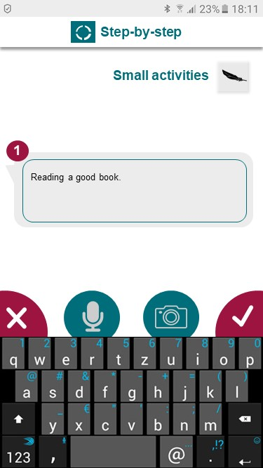
“Small activities”
i
People who are depressed, stressed or who experience grief often become inactive and withdraw from their usual activities.
This results in low mood that causes them to withdraw even more.
This cycle of inactivity can be broken by becoming active and doing enjoyable activities again.
Starting with simple and easy activities can build motivation.
Create a list of small activities that you normally enjoy doing.
Examples:
Going for a walk
Having a cup of tea
Relaxation exercise

Slide 14
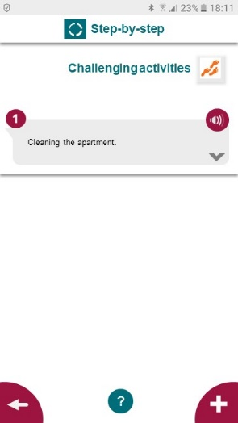
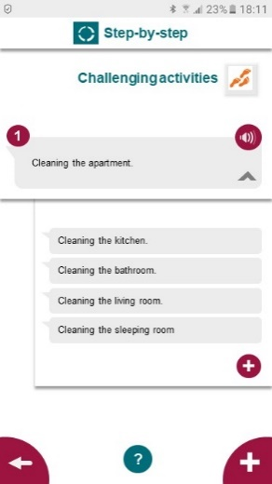
“Challenging activities”
i
Challenging activities are intended to further break the inactivity cycle.
These activities could give pleasure or provide a sense of achievement.
To be more manageable and less intimidating, challenging activities can be broken down into smaller steps.
Creating a list of challenging activities that are likely to improve mood or give a feeling of achievement.
Examples:
Write about my problems and thoughts
Clean the apartment
Breaking down a challenging activity into smaller steps.

Slide 15
“Be kind to yourself”
i
Positive self-verbalization, a simple but effective technique to address negative cognitions.
When it is hard to do an activity, the “be kind to yourself” exercise can be used.
Creation of a list of short encouraging messages.
Examples:
These activities are hard, but they will get easier.
I am really helping myself by taking these steps.

Slide 16
“Confidence booster”
i
An addition to the positive self-talk components and a simple technique to deal with difficulties during challenging activities.
When it is hard to do an activity, it may help to remember something that helps one feeling stronger and more confident.
Create a list of confidence boosters.
Examples:
Picture of a personal good luck charm

Slide 17
“Identify obstacles”
i
This introduces problem solving by addressing problems that occur with activities.
List of obstacles that might occur when doing activities or the steps of activities.
Adding solutions that can be tried when encountering these problems.
Examples:
Be kind to yourself
Confidence booster

Slide 18
“Plan activities”
i
Planer and reminders as means to improve adherence and to ensure that activities are integrated into daily routines.
Adding activities to the personal planer.
Picking activities from a list of activities.
For challenging activities, selecting one or more steps (instead of completing the whole activity all at once).
Picking a day and a time of day (morning, afternoon or evening).
Setting a reminder
Notification feature
Or personal offline reminders, e.g. a note on the fridge.
Marking completed activities.

Slide 19
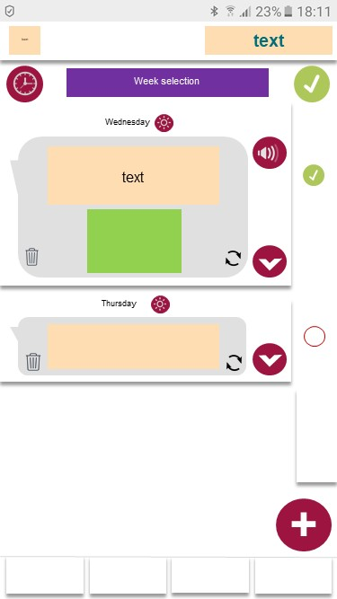
“Plan activities”
i
Planer and reminders as means to improve adherence and to ensure that activities are integrated into daily routines.

Slide 20
Step-by-step
Additional features

Slide 21
“e-helpers on-demand”
i
Guidance improves adherence.
E-helper messaging system
Contact-on-demand is integrated in the app
1. Pick a topic:
2. Send a message
3. Receive an answer by a trained and supervised e-helper (within 24 to 48 hours)
Content
Tech
Motivation

Slide 22
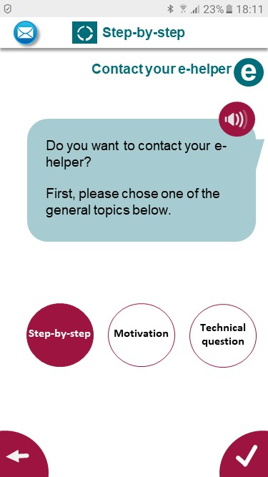
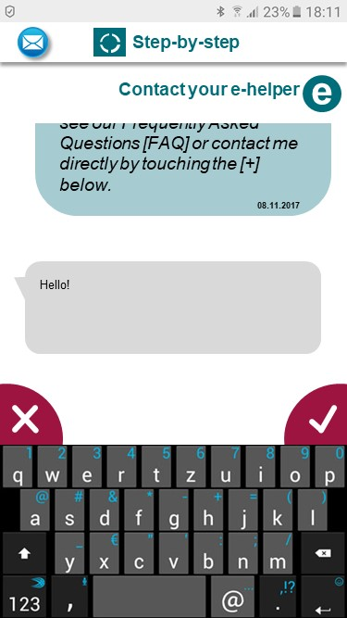
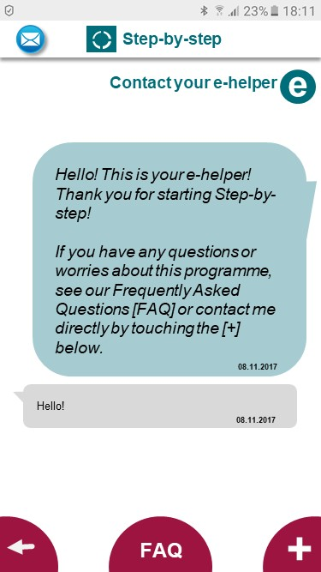
“e-helpers on-demand”

Slide 23
E-helpers
Syrians with a refugee background
Initial team:
Based in Germany
Background in Psychology (B.A. Psychology from Syria)
Psycho-social helper training

Slide 24
E-helper “backoffice”
Dashboard for e-helpers and coordinators
List of new clients
List of clients that are assigned to an e-helper
Messaging
Case notes
Administrative tools

Slide 25
Content Management System (CMS)
Change content
e.g.: correct typo
Remove / add content
e.g.: add information
No programming required

Slide 26
User-centred app development

Slide 27
Analysis of mHealth literature
Four major challenges of mobile mental health with implications for adaptation and implementation:
Credibility
Availability
Usability
UX → Retention

Slide 28
Credibility
Most of the available apps do not provide evidence based content and/or are not tested for efficacy
Review: Donker et al. (2013)
Review: Nicholas et al. (2015)
Review: Huguet et al. (2016)

Slide 29
Availability
Most of the evidence based apps are not available
Review: Donker et al. (2013)
Review: Grist et al. (2017)

Slide 30
Hybrid / Multi-Platform
i
The intervention should be available for both major operating systems.
Users who don‘t have a smartphone or don‘t want to download an app can use the web version.
The app can be downloaded to:
iOS
Android
There will also be a web version (with slightly limited functionality) for use with standard web browsers

Slide 31
Adaptability / Reusability
i
Dissemination requires shareable code that allows the creation of improved or extended versions.
Can potentially be the basis for other intervention adaptations.
Open source code
Modular programming
Industry standard & future proof tools
Well documented code

Slide 32
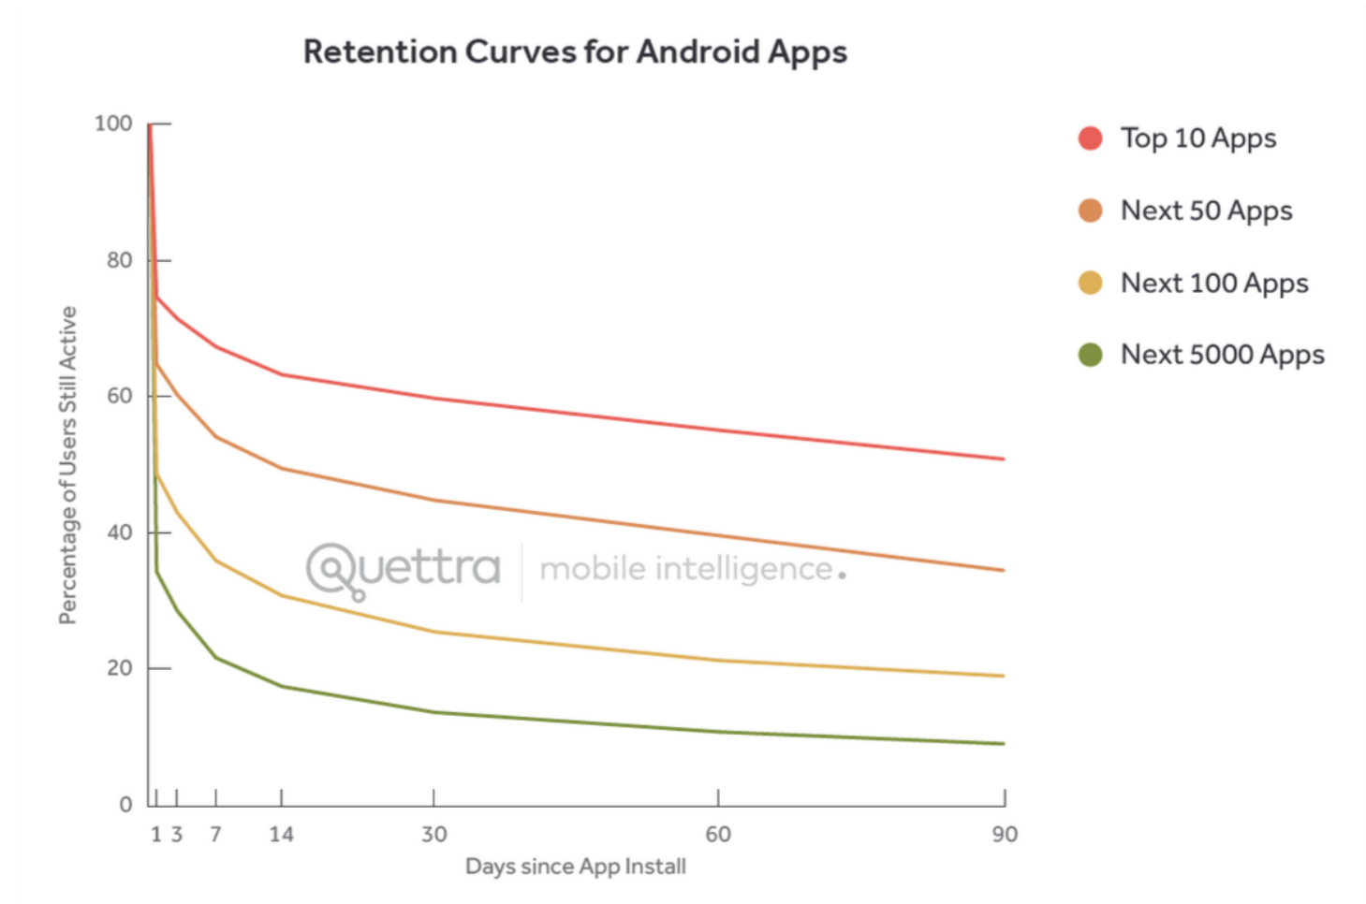
Retention
Apps in general have bad retention rates

Slide 33
Retention
mHealth Apps also suffer from this
e.g.
Roepke et al. (2015)
RCT on the depression self-help tool SuperBetter
26.15% of the sample left at post assessment
18.34% left at follow-up assessment

Slide 34
Usability
„Building an enjoyable app with good graphic design and satisfying interface is necessary for an effective intervention.“
Bakker et al. (2016)
“Mental Health Smartphone Apps: Review and Evidence-Based Recommendations for Future Developments”

Slide 35
Our tools for adaptation
List of evidence-based recommendations for future mHealth developments by Bakker et al. (2016)
Two usability evaluation frameworks
Brown et al. (2013) & Househ et al. (2015)
Kirwan et al. (2012)
Two digital intervention development frameworks
Mummah et al. (2016)
Whittaker et al. (2012)

Slide 36
Our tools for adaptation
List of evidence-based recommendations for future mHealth developments by Bakker et al. (2016)
We compared the existing Step-by-step version with the set of recommendations.
Room for improvement was identified for these aspects:
(Automated tailoring)
Reporting of thoughts, feelings and behaviours → Mood Tracking
(Real-time engagement)
(Activities explicitly linked to specific reported mood problems)
Gamification → Progress indicators (e.g. bars, stars, …)
Reminders to engage → Push notifications
Simple and intuitive interface and interactions → Usability focus

Slide 37
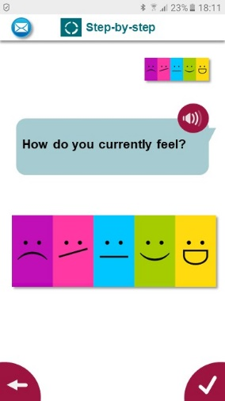
Mood Tracking
i
Regular mood tracking has effects on emotional awareness and has been shown to be an effective intervention in itself.
User are asked to rate their mood on a regular (e.g. daily or weekly) basis
Mood ratings can be added at any time and any number times
Mood pattern will be graphically displayed

Slide 38
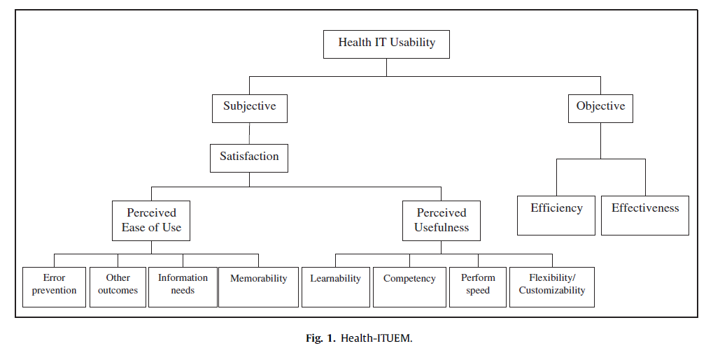
Our tools for adaptation
Two usability evaluation frameworks
Brown et al. (2013) & Househ et al. (2015)
Kirwan et al. (2013)
+ Health impact
Audio and picture as alternative input options for exercises.

Slide 39
Our tools for adaptation
Two usability evaluation frameworks
Kirwan et al. (2012)
Terminology
Navigation
Interface design
Feedback

Slide 40
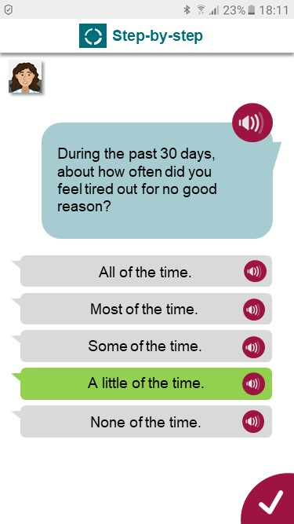
Audio support
i
Illiteracy rates among (younger) Syrian refugees are relatively high.
Older Syrians might have difficulties reading texts on smaller screens.
All texts and questionnaires come with on-demand audio-recordings

Slide 41
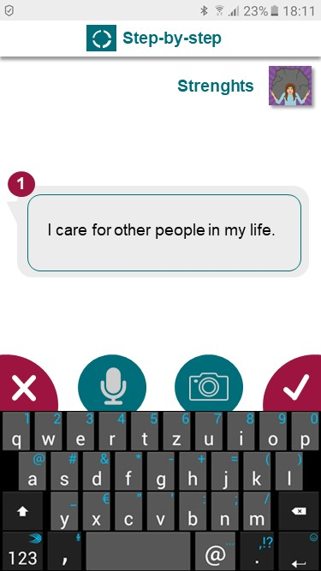
Input options
i
Illiterate users require alternative ways of using interactive exercises.
Different input options improve flexibility.
Interactive components of the app require user input
There are three different options:
Text input
Audio recording
Taking a picture

Slide 42
Offline use
i
Access to the internet and mobile internet data packages are often limited.
The app can be downloaded to a mobile device
Using the app does not require a permanent internet connection
However, data transfer requires internet access from time to time
Data download and data upload will be kept to a minimum

Slide 43
Our tools for adaptation
Two digital intervention development frameworks
mHealth development is an iterative process
Steps of the IDEAS framework (Mummah et al., 2016) Empathize with target users Specify target behaviour Ground in behavioural theory Ideate implementation strategies Create prototypes Gather user feedback on prototypes Build a fully functional pilot version Pilot the intervention Evaluate efficacy Share widely | Design process phases (Whittaker et al., 2012) Conceptualization Understanding behaviour Identifying intervention options Identifying content and implementation options Formative research Pretesting Pilot trial Pragmatic randomized controlled trial Qualitative research Scaling-up and implementation evaluation
WP3
WP6 & WP8

Slide 44
Tool for prototyping

Slide 45
Qualitative assessments on Prototype
Health impact (mostly very positive)
“…especially in a country where we live in isolation mostly in winter, when we have our phones all the time in hand, it’s nice to have some program like that home, easy going that can help you when you’re depressed while nobody else knows about that, this is a positive and interesting thing.”
(Sweden)

Slide 46
Qualitative assessments on Prototype
Terminology (mostly positive)
“The language is good, as it is very close to the Syrian dialect, as if someone is speaking to you, better understands you and not academic, which is better than the formal Arabic language.”
(Egypt)

Slide 47
Qualitative assessments on Prototype
Interface design (rather controversial)
“The characters are not attractive, they look very normal and Syrians are very diverse. The girl with hijab doesn’t look like Syrian girls, you feel she is an extremist because of the black colour.”
(Sweden)
“The illustrations are very good.”
“The pictures are expressive.”
(both Egypt)

Slide 48
Qualitative assessments on Prototype
Performance speed (mostly negative)
“The program must be faster. I mean there should be more sessions every week, for example, a session every 3 days.”
(Germany)
Memorability
“The introduction and the messages are too long in a way that the beneficiary might forget the app’s objective.”
(Egypt)

Slide 49
Qualitative assessments on Prototype
UX → Engagement
“A nice app, but a little bit boring.”
(Sweden)
“The sessions are attractive, as if it`s an adventure.”
(Egypt)
“Anyone who sees the app will be curious to try it out.”
(Egypt)

Slide 50
Next adaptation steps
Iterative process
We will continue to do user testing in 2018
Room for improvement
Shortening sessions:
Not in regard to content, but:
Having more sessions at shorter intervals
Improvements to user interface and navigation
Focus on UX and engagement
Working with a software development company

Slide 51
WP6

Slide 52
Overview of activities in Work Package 6
Public tender (until now)
Preparation of documents:
Based on technical requirements document
User stories, mockups & prototypes
First round released on October 9th 2017
11 applications
5 companies selected for round 2
Second round released on December 21st 2017
2 applications

Slide 53
Overview of activities in Work Package 6
Public tender (next)
Bidder presentations
Negotiations
Signing contract and start of programming

Slide 54
Overview of activities in Work Package 6
Software development
starts in February
first test version in April
pilot version by the end of June = Milestone
after pilot: creation of final version by end of December

Slide 55
Overview of activities in Work Package 6
Ethics applications for RCTs
applied at FUB on July 11th 2017
approved on August 17th 2017
Applying for WHO ethics in February

Slide 56
Overview of activities in Work Package 6
Assessing approaches to integrate Sbs into health care systems
Speaking with stakeholders:
Government institutions, e.g. General Secretariat for Mental Health and Addiction treatment in Egypt
(Social media) Community leaders, e.g. admins of the three largest Syrian facebook groups in Germany
NGOs, e.g. Swedisch Red Cross

Slide 57
Overview of activities in Work Package 6
Training of contact-on-demand providers
Planned for beginning of May

Slide 58
Overview of activities in Work Package 6
Pilot trials
Planned for July
not in all countries at the same time

Slide 59
Overview of activities in Work Package 6
definitive RCTs
Beginning of 2019
not in all countries at the same time

Slide 60
Overview RCT Design

Slide 61
Trials (overview)
Pragmatic randomized (cost-)effectiveness trials with process evaluation
Three separate trials with parallel design
Germany, Sweden and Egypt
Two-armed design
A: Step-by-step app + enhanced TAU
B: Enhanced TAU

Slide 62
Control condition
(enhanced) treatment-as-usual (TAU)
TAU is most likely: no treatment at all
Enhancement:
Information on where to find an how to access treatment
country specific information
No other features of the app (e.g. mood tracking, contact-on-demand)

Slide 63
Trials (overview)
3 pilot trials with N = 60 participants each
3 definitive RCTs with N = 532 participants each
Syrian refugees with elevated levels of psychological distress (K10) and reduced psychosocial functioning (WHODAS)
18+ years
No plans to end their life (screening questions)
All assessments within the app
both conditions

Slide 64
Measures
Overview of Measures (RCTs)
 | Measures
Concept | Screening |  | Baseline | Weekly | Post & Follow-up
Functioning | WHODAS 2.0 |  |  |  | WHODAS 2.0
Distress | K10 |  |  | K10
 |  |  | HSCL-25 |  | HSCL-25
PTSD |  |  | PCL-5 |  | PCL-5
Self-identified problems |  |  | PSYCHLOPS |  | PSYCHLOPS
Traumatic events |  |  | LEC |  | LEC
Post-migration stressors |  |  | PMLD |  | PMLD
Cost of care |  |  | CSRI |  | CSRI
Mood |  |  |  | Smiley-Scale
Suicidality risk assessment | Screening items
Demographics | WHODAS 2.0
Access to health services |  |  | Access to care |  | Access to care
Fidelity |  |  |  |  | Fidelity checklists / usage data

Slide 65
Trials (overview)
Expected effect size (primary outcome at 3-months):
Mean difference between both arms
d = 0.4
Sample size calculation:
Power = .90 and alpha = .05
2x 133 = 266
Attrition of 50% at 3 months
266/0.5 = 532

Slide 66
Recruitment

Slide 67
Recruitment
Public and private primary health care facilities
Non-specialist and specialist centers and refugee organizations
Community settings, language schools, integration courses, refugee homes
Cooperations with NGOs
Cooperations with government institutions
Posters and flyers
Social media

Slide 68
Recruitment partners
Egypt
Cooperation with Caritas, Alexandria
Extensive database of Syrian refugees
Cooperation with the General Secretariat for Mental Health and Addiction treatment
Sweden
Swedish Red Cross is very interested
Germany
“Syrisches Haus” Facebook group
206.743 members (January 26th 2018)

Slide 69
Additional activities

Slide 70
Additional activities
Development of an additional module
Emotional exposure
Likely based on Unified Protocol (Barlow)
Testing the expandability of the app

Slide 71
Additional activities
WHO Step-by-step study in Lebanon
Sharing the software with WHO
Testing the adaptability of the software

Slide 72
Additional activities
Implementing a content version for younger users
Slightly adapted version for younger adults
Mostly removing too strong references to husband/wife and children
Testing the tailoring capabilities of the software

Slide 73
Additional activities
Open trials
No control group
(Likely) no contact-on-demand
No restrictions
100% anonymous

Slide 74
Thank you!

