Slide 1
WP3

Slide 2
Work Package 6
Online Implementation
“This work package will implement the evidence based PM+ programme by creating an online and offline computer and smartphone based version for Syrian refugees.”

Slide 3
Work Package 3
Adaptation
Task 3.2 “Adaptation of ePM+”
“The pre-existing WHO concept for electronic PM+ will be further adapted and a culturally adapted contact-on-demand functionality will be developed.”

Slide 4
Work Package 3
Aim
To create a highly scalable, flexible and adaptable digital intervention.
reduce costs and effort for implementation with large reach
compatible with different health care systems / can fill gaps
open (software and conceptual) basis for future versions, additions and new interventions

Slide 5
Overview of activities in Work Package 3
Desk-research and consultation
Use of ICTs among Syrian refugees
information and communications technologies
Step-by-step
mHealth development frameworks

Slide 6
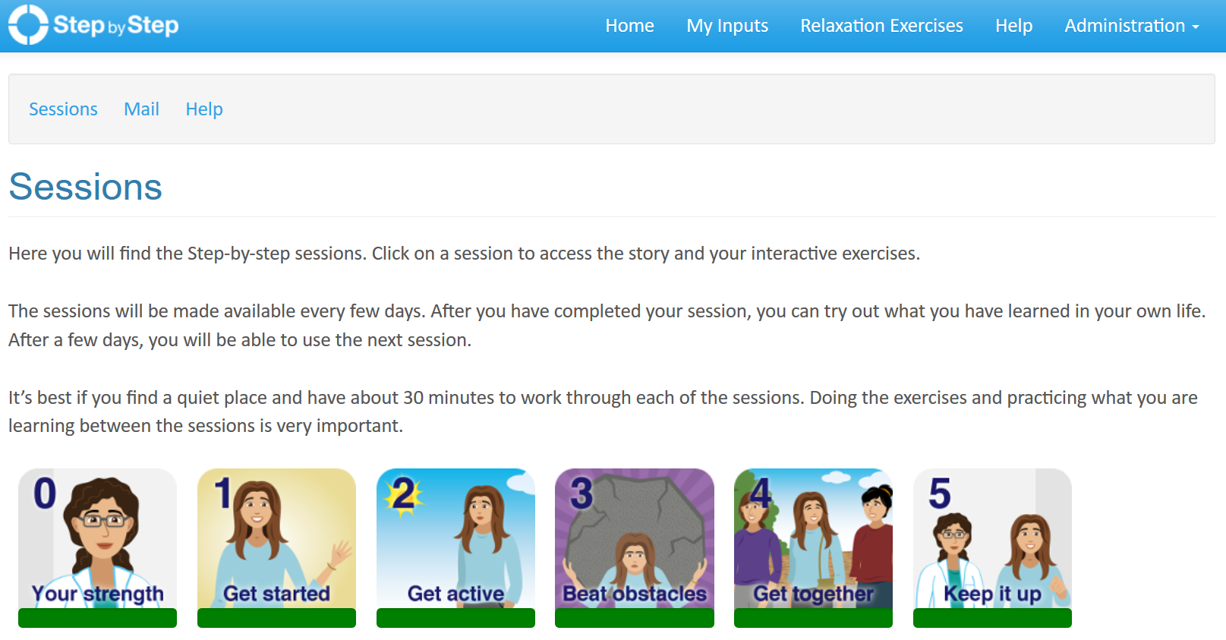
eHealth version of PM+
„Step-by-step“
Developed by WHO and University of Zurich
Current web-based version:

Slide 7
Overview of activities in Work Package 3
Ethics application: qualitative assessments
applied at FUB on April 11th 2017
approved on June 12th 2017

Slide 8
Overview of activities in Work Package 3
Qualitative assessments
Free listing interviews
20 per country
general RQA questions + questions on ICTs
Key informant interviews
12 per country
general RQA questions + prototype testing
Focus group discussions
2 per country
prototype testing + contact-on-demand discussion

Slide 9
Overview of activities in Work Package 3
Concept for contact-on-demand
In-App e-helper messaging system
1. Pick a topic:
2. Send a message (text or audio)
3. Receive an answer by a trained and supervised e-helper
(text or audio)
Content
Tech
Motivation

Slide 10
Overview of activities in Work Package 3
Technical requirements document
Functional requirements (What?):
e.g.: be able to send and receive messages
Non-functional requirements (How?):
e.g.: can be used when offline
also: data protection and data security
Global requirements (often a result of constraints):
e.g.: Hybrid programming

Slide 11
Overview of activities in Work Package 3
User stories, wireframes, mockups & prototypes
User story:
As a client I want to access my inputs, in order to revisit previous exercises.
Wireframe: …
Mockup: …
Prototype: …

Slide 12
Overview of activities in Work Package 3
User stories, wireframes, mockups & prototypes
Wireframe:

Slide 13
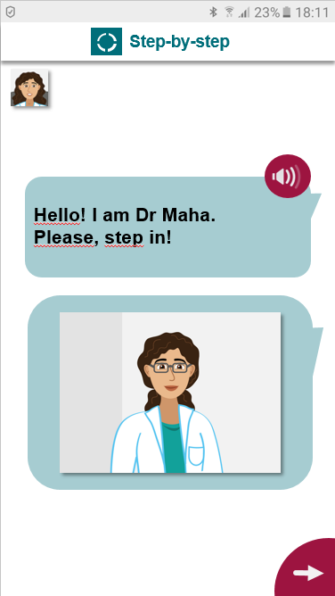
Overview of activities in Work Package 3
User stories, wireframes, mockups & prototypes
Mockup:

Slide 14
Overview of activities in Work Package 3
User stories, wireframes, mockups & prototypes
Prototype: (…)

Slide 15
Overview of activities in Work Package 3
Adaptation report
Sections on Step-by-step
Sections on Egypt, Sweden and Germany

Slide 16
Overview of activities in Work Package 3
Next: Training materials
Sections on contact-on-demand
ToT for Step-by-step
E-helper training for Step-by-step (STRENGTHS version)

Slide 17
Overview of activities in Work Package 3
Next: Training pilot and evaluation
Combined with software testing (WP6)

Slide 18
Thank you!

