Slide 1
WAR CHILD HOLLAND
EASE Lebanon
26 January 2018
Strengths Consortium meeting
Denmark, Copenhagen
Felicity Brown, Frederik Steen, Mark Jordans

Slide 2
What is EASE?
Designed for young adolescents (10-14 years old) experiencing adversity, and impaired by distress
Delivered by non mental-health professionals
Delivered in groups (around 8 adolescents)
7 Sessions for children, 3 for parents
Methods used:
Identifying feelings
Stress management
Behavioral activation
Problem solving
Notes:
1- developed by Who with input from many experts

Slide 4
Phase 1- Cultural Adaptation - Process
1b. Desk Review
1d. Psychologist read through
1e. Mock sessions EASE
1c. Cognitive interviewing
1a. Rapid Qualitative Assessment
ADAPTTION WORKSHOP
21-22 Sept Beirut
OUTPUTS
Bernal framework completed
Revision EASE materials

Slide 5
Phase 1- Cultural Adaptation – Procedures
1b. Desk Review
1d. Psychologist read through
1e. Mock sessions EASE
1c. Cognitive interviewing
1a. Rapid Qualitative Assessment
- Two communities in North Lebanon
- FL (n=24), FGD (4 groups, n=15), KII (n=23).
- Children, Parents, Community Members, and MH Care Providers.
By Master Student (LSHTM)
Existing Desk Reviews WCH Lebanon
- 4 CI groups (n=16); caregivers and children in North Lebanon
- Selection of Arabic EASE materials: Storybook for adolescents;
Posters for adolescents; Parts of EASE manual; Caregiver handouts
By 5 Lebanese WCH researchers and PSS trainers/advisors
Arabic Manual, Arabic Storybook and Arabic Workbook
feedback on comprehensibility, acceptability and formulation
Run-through by 9 participants: Lebanese WCH Researchers and PSS trainers/advisors and non-Lebanese psychologists, researchers (WHO, DRC and WCH)
Notes:
RQA/Desk:
Outputs
List of Free listing problems
List of Free listing activities, to be used for general functioning instrument development
Dissertation MSC students on RQA findings, incl. desk review
Internal report RQA findings
Brief findings:
Main problems
Emotional Abuse, bullying and physical violence
Substance use
Poverty
Positive Coping mechanisms
Talking with parents (especially mother),
Seeking assistance,
Playing/doing activities,
Friendships etc.
Etc.

Slide 6
Phase 1 – Cultural Adaptation – Example adaptations
Addressing aggression and bullying throughout
Reducing resources needed- such as costumes, coloured pencils
Prioritising problems during problem solving
Quality time needs to consider large families, limited space, and limited time

Slide 7
Phase 1 – Trainings + Timeline
Master Workshop
Jan 2018
Training of Trainers
Feb 2018
Practical Cycle
April 2018
Measures finalized
April 2018
2 days
8 days
Full cycle
Trainers
Training of Facilitators
June 2018
Practice Run Facilitators
Jul-Aug 2018
Training of RAs
July 2018
Start Pilot RCT
Aug-Sep 2018
Full cycle Facilitators
5 days
8 days

Slide 8
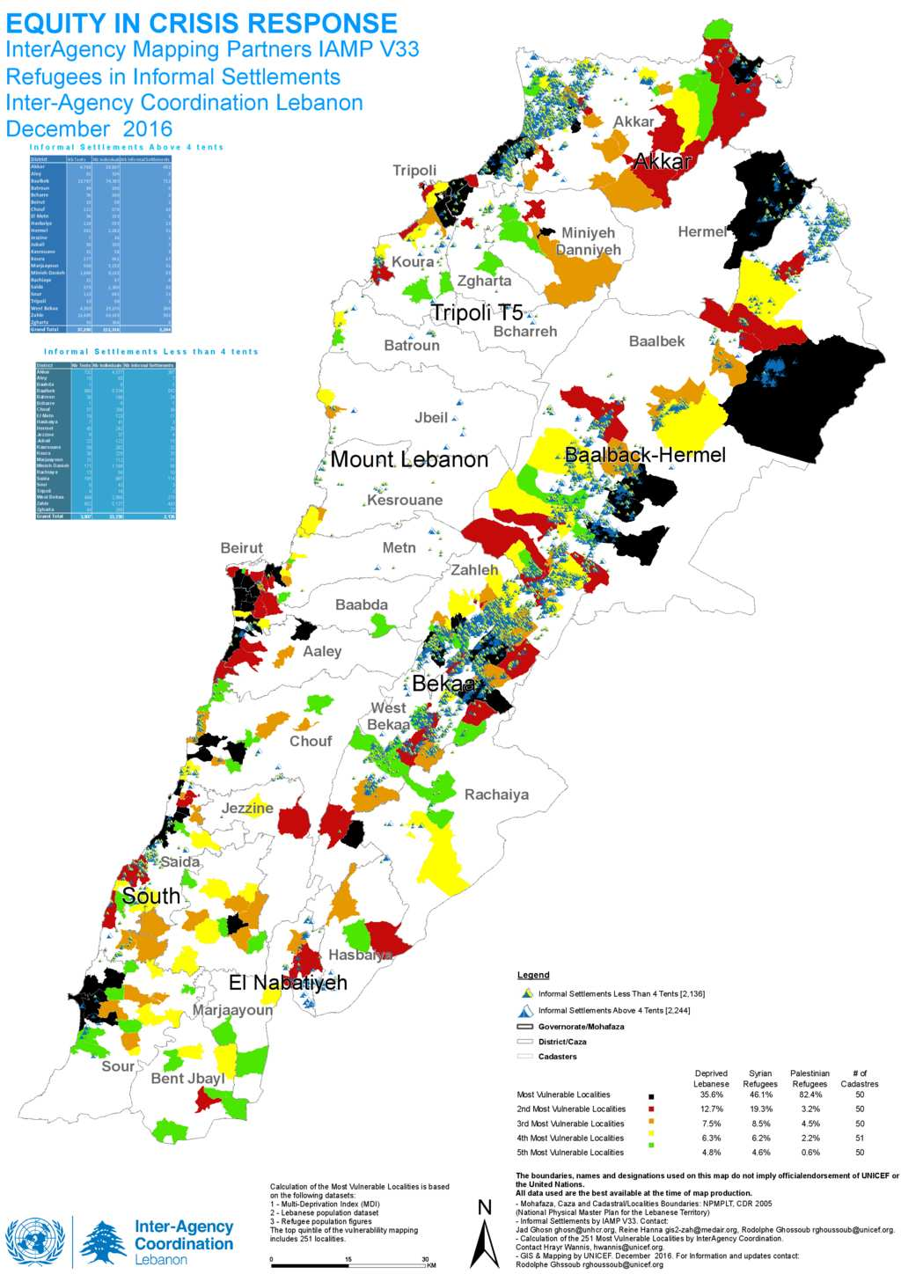
Phase 2 - Location for EASE trial
Embedded in Back 2 the Future Education program
Location: Most vulnerable regions in Tripoli and Akkar
Camp settlement, Village and Urban Settings
Lebanese, Syrian and Palestinians Program
Nine Community Centers feasible for EASE
Ethical approval from St. Joseph University & WHO (almost)
Notes:
Segregation of groups still under discussion

Slide 9
Phase 2 – Pilot Study (1)
2 locations in North (Tripoli) and Akkar
Sample: 128 children
64 children in 4 EASE groups - Groups divided on age and gender
64 children in the ETAU condition
Steps:
Parental consent and child assent for screening
Screening of child
Parental consent and children assent for study participation
Baseline
Randomization to ETAU and EASE
Assessment: Post intervention and 3-months Follow up
ETAU
Scripted individual sessions with parents and children by facilitator to cover:
Psychoeducation (screening results, self-help techniques)
Referral options to MHPSS services

Slide 10
Phase 2 – Pilot Study (2)
Inclusion
Aged between 10 years and 14 years
Lebanese national, Syrian or Palestinian refugee
Able to follow and understand instructions
Has a caregiver who has provided consent for participation
Screens positive for psychological distress, based on CPDS
Exclusion
Unaccompanied minors
Adolescents with significant cognitive impairment, severe neurological impairments or developmental difficulties as determined by caregiver-report on the TQ-10 (Durkin et al, 1990).
Adolescents at risk of imminent suicide, assessed using structured interview questions

Slide 11
Measurements Instruments
Domain | Tool | Number of items
Screener measures
General child psychosocial distress | Child Psychosocial Distress Screener (CPDS) | 7 (5 child; 2 Caregiver)
Outcome measures
Primary
Child-reported general child psychological distress | Pediatric Symptom Checklist – youth version (Y-PSC) | 35
Secondary
Caregiver-reported general child psychological distress | Pediatric Symptom Checklist – caregiver version (PSC) | 35
Depression | Patient Health Questionnaire 9 for adolescents (PHQ-9) | 9
Posttraumatic stress | The Children’s Impact of Events Scale (CRIES-8) | 8
General functioning | Impairment in daily functioning | 10
Well-being | Short Warwick-Edinburgh Mental Wellbeing Scale (SWEMWBS). | 14
Caregiver Measures
General psychological distress | Kessler 6 (K6) | 6
Parenting | Alabama Parenting Scale | 42 or short 15-item
Exposure to traumatic events | Harvard Trauma Questionnaire (HTQ) | 17
Other
Fidelity and Competency checklist for Facilitators

Slide 12
Adaptation and Validation of measures
All measures:
Forward translation to colloquial Arabic
Backwards translation to English (separate translator)
Translation workshop to finalise translations
Cognitive interviewing
Revision and finalization of measures
Validation of Paediatric Symptom Checklist and Child Psychosocial Distress Screener :
n = 100 adolescents aged 10-14
concurrent validity with psychiatrist interview using KSADS

Slide 13
Phase 3 - Process evaluation
Target groups: EASE adolescent participants (completers and non-completers); EASE caregivers; ETAU participants (completers and non-completers); ETAU caregivers; EASE facilitators; Supervisory and clinical staff.
Methods: FGDs and KIIs
Themes covered in these interviews, amongst others:
Challenges and enablers in implementation of EASE/ETAU etc.
Caregiver’s views on motivators and barriers to supporting adolescent participants of the program
Barriers and facilitators to recruitment, adherence and attrition within a randomized study design
Notes:
Sample size based on empirical saturation- max 12 per group
Purposeful sampling will be conducted to ensure a suitable sample to address the qualitative research questions, with attention to sex, age, nationality, and other demographics.

Slide 14
Timeline

