Slide 1
WP2: HEALTH SYSTEMS
25 January 2018
Bayard Roberts, Daniela Fuhr
London School of Hygiene and Tropical Medicine
Egbert Sondorp, Aniek Woodward
KIT Royal Tropical Institute

Slide 2
WP2 Aim and objectives
Aim | To analyse the responsiveness of health systems to the scaling-up of PM+ across European host countries and LAMIC bordering Syria in addressing the mental health needs of refugees.
Objective 1 | To analyse the responsiveness of health systems across European host countries and LMIC bordering Syria in addressing the mental health care needs of refugees.
Objective 2 | To examine how contextual factors such as socio-economic, cultural, and political-economy factors influence the responsiveness of health systems to the mental health care needs of refugees in the project countries.
Objective 3 | To explore how the scaling-up of the low-intensity PM+ programmes can support health system responsiveness to the mental health care needs of refugees in the project countries
Objective 4 | To compare the responsiveness before and after implementation of the PM+ programmes of the health systems of European and LAMI countries bordering Syria

Slide 3
WP2: Overview of main activities
Rapid appraisals of health system responsiveness
Desk reviews
Qualitative research
Cross-sectional community-level surveys (two countries)
Analysis of quantitative data from other WPs
In-depth qualitative research
Theory of Change workshops
Repository/database of relevant literature

Slide 4
Progress overview: Conceptual work
Health system analysis framework

Slide 5
Responsiveness domains

Slide 6
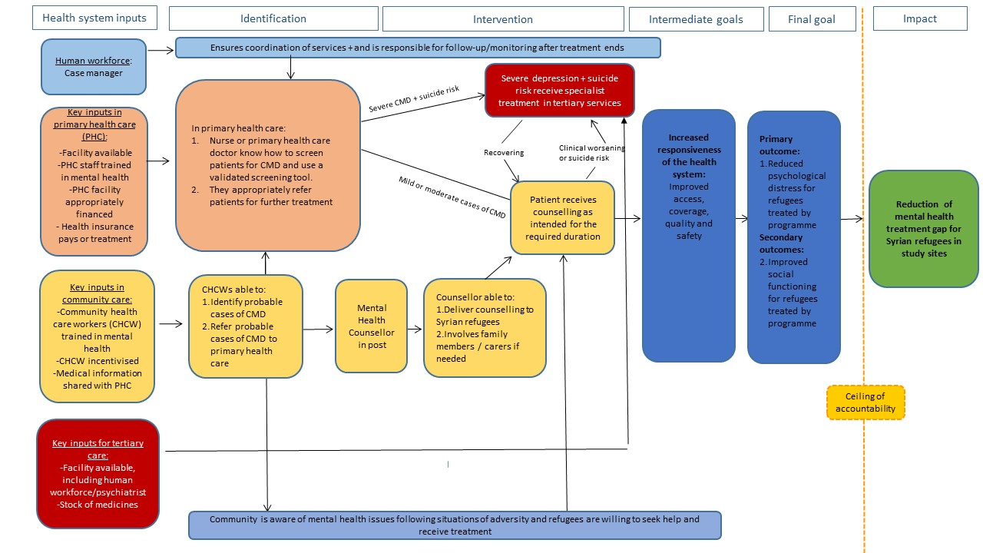
Care pathways based on mhGAP

Slide 7
Progress overview: Rapid appraisals
Aim of rapid appraisals: To assess the responsiveness of the health care system to the psychosocial needs of Syrian refugees, based on an assessment of the way Syrian refugees with mental health needs navigate the health care system
Method: collection and triangulation of multiple data sources, including:
desk-based reviews of existing evidence, reports, policies, guidelines and data through systematic methodology.
semi-structured interviews and focus groups with purposively selected key stakeholders in the project countries (e.g. refugees, health/social workers, health system and mental health experts (e.g. MoH, NGOs, UN, academics).

Slide 8
Progress overview: Rapid appraisals
RA activities | Status
Adapting RA methodology for MH systems analysis
Developing research protocol & conceptual approach
Gaining ethics approval
Desk study
Literature reviews for all project countries
Data extraction for all project countries
Completion of Annex Inputs for all project countries
Analyze qualitative data available from partners
Write narrative reviews for all project countries
Field work
Contact WP leads to get support
Logistics & finances in place
Finalize RA topic guides, translation and training
Conduct qualitative interviews in all project countries

Slide 9
Progress overview: Cross-sectional surveys
Aim: To collect evidence on MHPSS needs and access to MHPSS care among Syrian refugees in two study countries.
Method:
Community-level cross sectional surveys.
Sultanbeyli municipality of Istanbul, Turkey; and in Leipzig, Germany
Straight random sampling
Survey activities | Status
Develop research protocol
Gaining ethics approval:
LSHTM
Turkey
Germany
Field work:
Identify country research partners
Logistics & finances in place
Finalise sampling design & instrument
Conduct piloting
Data collection Turkey
Data collection Germany
Data cleaning
Data analysis

Slide 10
Dissemination
Presentations:
LSHTM Centre for Evaluation Seminar, March 2017
ESTSS, Odense, June 2017
European Congress of Psychology, Amsterdam, July 2017
Submission for Health Systems Research Conference (Liverpool, October 2018)

Slide 11
Activities for the next 12 months
Writing-up rapid appraisals (reports, briefs, publications) & dissemination
Develop repository/database of relevant literature for each study country (place on STRENGTHS website)
Complete survey in Turkey; finalize survey arrangements in Germany
Write survey papers and policy briefs (Turkey first) & dissemination
Prepare procedures and methods for analysis of quantitative data from partners
Hold Theory of Change workshops
Prepare procedures for in-depth qualitative research

Slide 12
WP2 needs
Rapid appraisals:
Checking our collation of data/literature and RA reports
Sharing relevant qualitative data already collected by partners
Working with us for additional qualitative data collection (if required)
Analysis of quantitative data from other WPs
For data related to access/utilisation
In-depth qualitative research (2019)
Support development of topic guides
Support us with data collection and dissemination

Slide 13
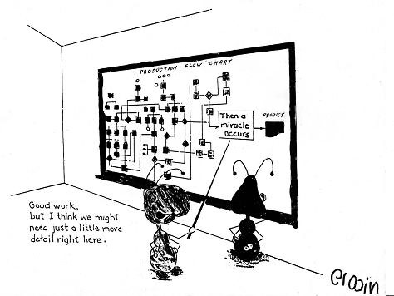
Theory of Change (ToC)
A participatory planning process used in the development, implementation and evaluation of complex health interventions

Slide 14
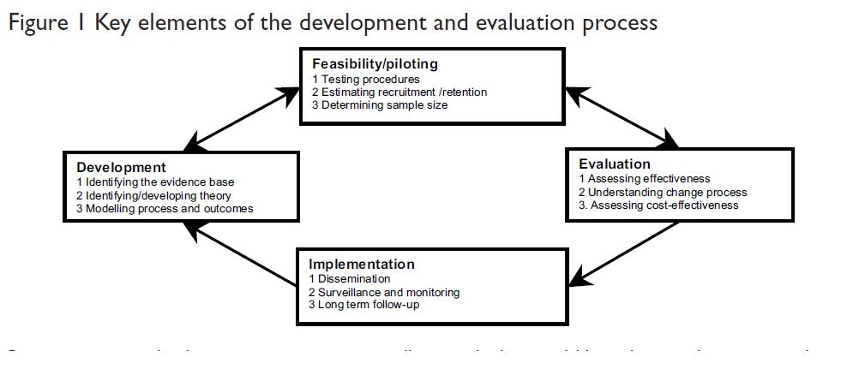
ToC: A theory driven approach to enhance the MRC framework
MRC framework, 2008

Slide 15
Theory of Change

Slide 16
Resources
Identification
Treatment
Long term outcome
Impact
Intervention coordinator (IC) in post
Adequate ongoing programme management and clinical supervision
Co-morbid psychosis/suicide risk mothers receive specialist treatment in tertiary services (viii)
In antenatal and immunization clinics, IFs able to: (ii)
Recruit and conduct regular supportive supervision of Peer Support Workers (PSWs)
Identify mothers with depression using screening tools and appropriately refer them for treatment (iii)
Conduct awareness raising in hospital clinics
Nurses encourage mothers to participate in programme
Co-morbid psychosis/suicide risk
Intervention facilitators (IF) in post. Hospital clinic nurses aware of programme.
Primary outcome:
Improved clinical outcomes for mothers with depression treated by program
(ix)
Secondary outcomes:
Improved social functioning (x)
Improved child health outcomes (e.g. adequate breast feeding, improvement in infant weight)
Recovering
No improvement after 3 sessions
Mothers receive counselling as intended for the required duration (vi)
Reduction in treatment gap for maternal depression in district
No co-morbid psychosis/suicide risk
Community Health Workers (CHWs) aware of programme (i)
CHWs able to:
Help the IFs identify, recruit and supervise PSWs
Conduct community awareness raising
PSWs in post & integrated into hospital system
(iv)
PSWs able to:
Deliver counselling
Appropriately refer mothers
Conduct community awareness raising (v)
Ceiling of accountability
Community is aware of peer counselling and mothers are willing to seek help and receive treatment (vii)
Key
Specialist care/ tertiary services
Community Health Workers (CHWs)
Intervention needed
Intervention co-ordinator(IC)
Peer Support Workers (PSWs)
A
Assumption
Example of ToC map
Thinking Healthy Programme- Peer-delivered
1
Intervention
Intervention Facilitator (IF), nurses
Community
a
Rationale
(i)
Indicator

Slide 17
Theory of Change
Constructing a ToC map is particularly effective when:
it is undertaken as early in intervention or programme development as possible
it involves a range of key stakeholders in an interactive workshop
BUT:
ToC is a participatory planning process which can be used for development, implementation and evaluation of complex interventions

Slide 18
Relevance for STRENGHTS?
ToC can assist in:
Planning the process of scaling up in the different study countries
Planning the implementation of a (national) strategy within a broader health systems framework (e.g. STRENGHTS partners in Lebanon)
Developing complex interventions as part of formative research
→ To be discussed: Potential value and purpose of ToC in STRENGHTS

Slide 19
Thank you

