Slide 1
STRENGHTS-NL
Consortium meeting Copenhagen
January 2018

Slide 2
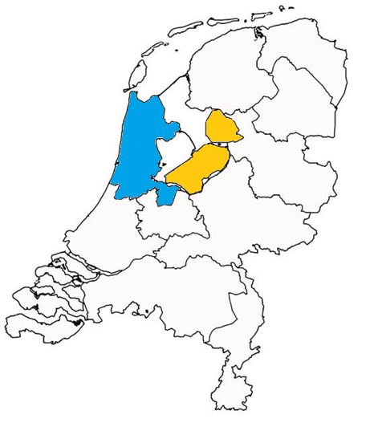
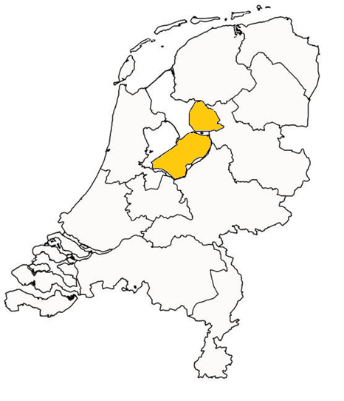
Notes:
Barbara and I are presenting together today since Barbara’s team at i-Psy and the VU are working together to conduct the PM+ trials in the Netherlands.
The aim is to integrate PM+ into i-Psy’s care package.
There are different i-Psy locations in almost all provinces in the Netherlands.

Slide 3
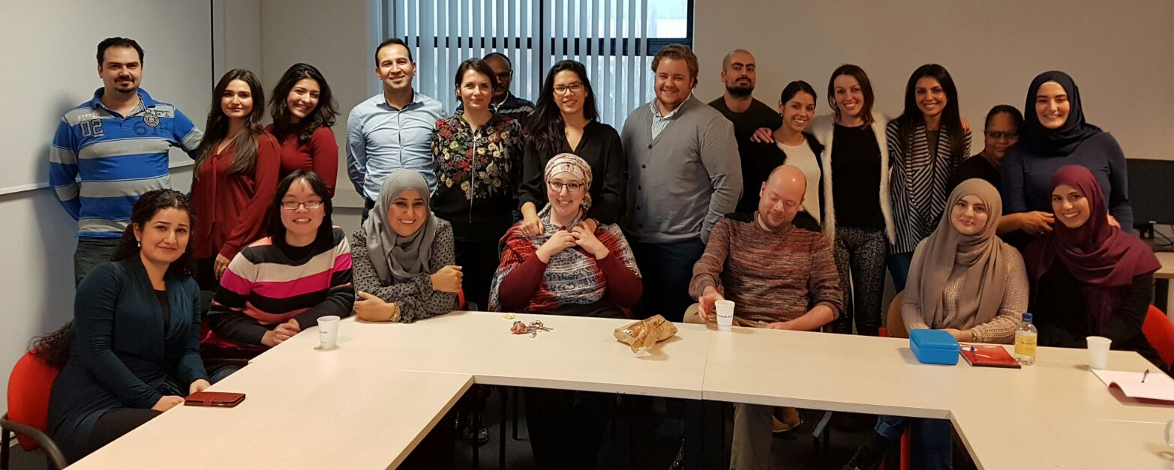
i-psy Mental Health Care
Transcultural mental health care institution
Country-wide
Migrants & refugees, asylum seeker centers
Specialized care package
In STRENGTHS:
Master trainers
ToTs
PM+ providers

Slide 4
i-psy Partner in STRENGTHS
March 8-16
Master trainer
ToTs
Psychiatrists and licensed psychologists
Arabic-speaking MSc psychologists
PM+ providers
Persons with a Syrian (refugee) background
At least 16yrs of education
Background in health care or related field
Arabic and English/Dutch
Pilot: end of March
RCT: Summer?

Slide 5
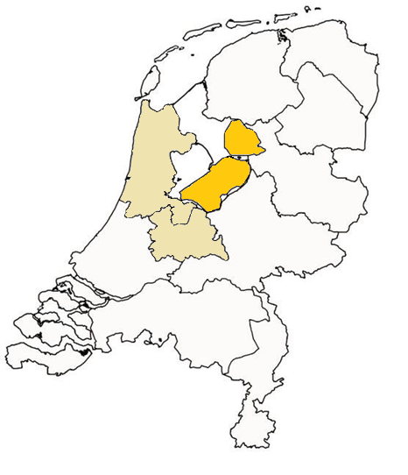
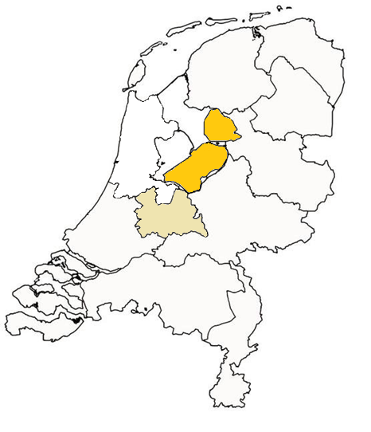
Upscaling PM+ Through i-psy
Notes:
Barbara and I are presenting together today since Barbara’s team at i-Psy and the VU are working together to conduct the PM+ trials in the Netherlands.
The aim is to integrate PM+ into i-Psy’s care package.
There are different i-Psy locations in almost all provinces in the Netherlands.

Slide 6
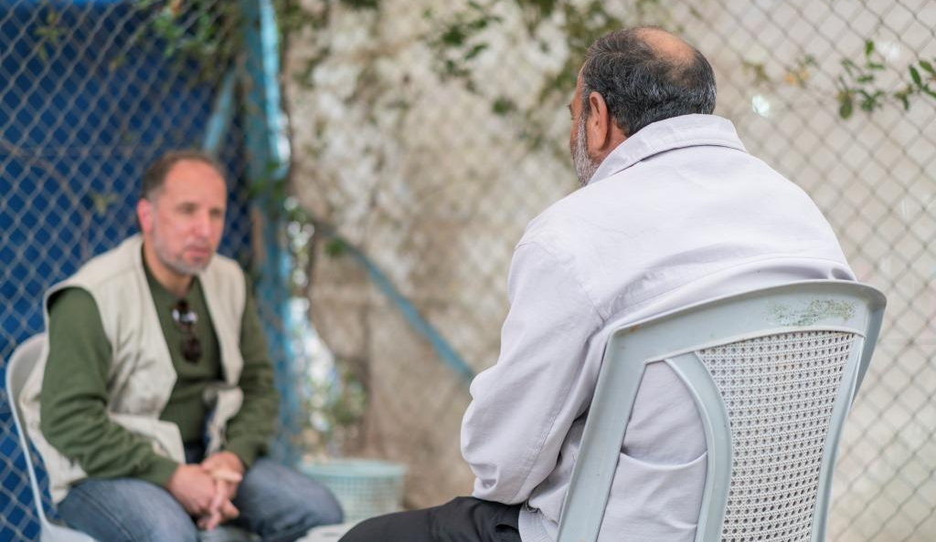
Step 1 Definitive choice PM+ version: Individual

Slide 7
Step 2 PM+ Individual trials in the Netherlands
Written and verbal information provided by i-psy/VU
One week later:
Signing 1 IC
Screening and baseline at same assessment point
PM+ Individual
Issues to consider:
Different locations in NL
Home visits
Asylum seeker centers

Slide 8
Care as usual in the Netherlands
Basic health insurance (BHI) package
Free for asylum seekers/refugees
Legally required for persons with residence permit
Primary health care services only
Mental health services not included in BHI package, except:
Primary mental health care integrated in GP practice
Preventive care
Asylum seekers/refugees have access to specialized care, but:
Long waitlists
Difficulties with language
Unfamiliarity with Dutch system, etc.

Slide 9
Actions to complete in 2018
Action | Completed by month
Training of (peer-master) trainers Amsterdam | 15
Training of local PM+ providers | 16
Recruitment and training of i-psy PM+ providers | 18
Pilot trial and process evaluation | 24

