Slide 1
Castor EDC
Consortium meeting Copenhagen
January 2018

Slide 2
Castor EDC
General Information
Trial management:
  Includes ‘patient record forms’
  Randomization
  Distribute surveys or import collected data
  Export data into CSV and other files
You can use the same registration for the pilot and RCT (automation option)
Technically possible to use one registration for multiple sites (doubtful if handy) → “Structure” can be downloaded and shared among partners
Notes:
Barbara and I are presenting together today since Barbara’s team at i-Psy and the VU are working together to conduct the PM+ trials in the Netherlands.
The aim is to integrate PM+ into i-Psy’s care package.
There are different i-Psy locations in almost all provinces in the Netherlands.

Slide 3
Castor EDC
Quality Standards
Complies with all regulations of Good Clinical Practice (GCP), 21 Code of Federal Regulation (CFR) Part 11, EU Annex 11, and the European Data Protection Directive.
ID code automatically generated at time of enrolment.
All entered data and all changes will be automatically saved throughout the study (audit trail, data trail and edit trail).

Slide 4
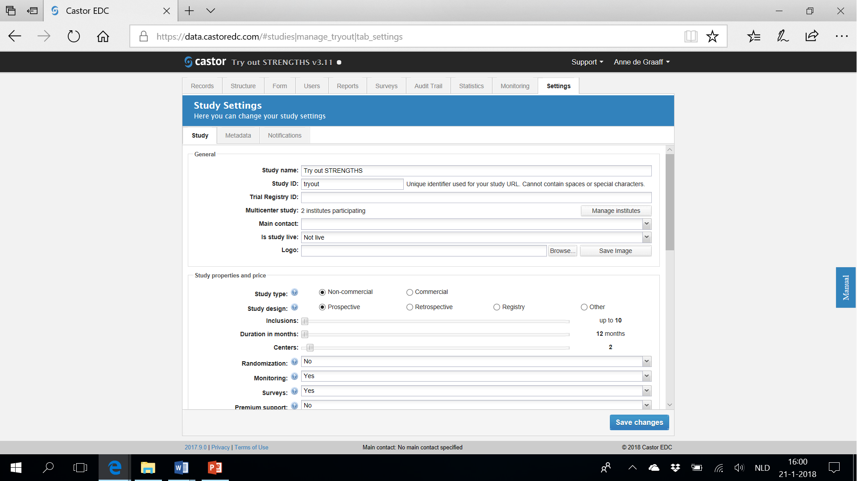
Study Settings
Define Design, Add Centers, …

Slide 5
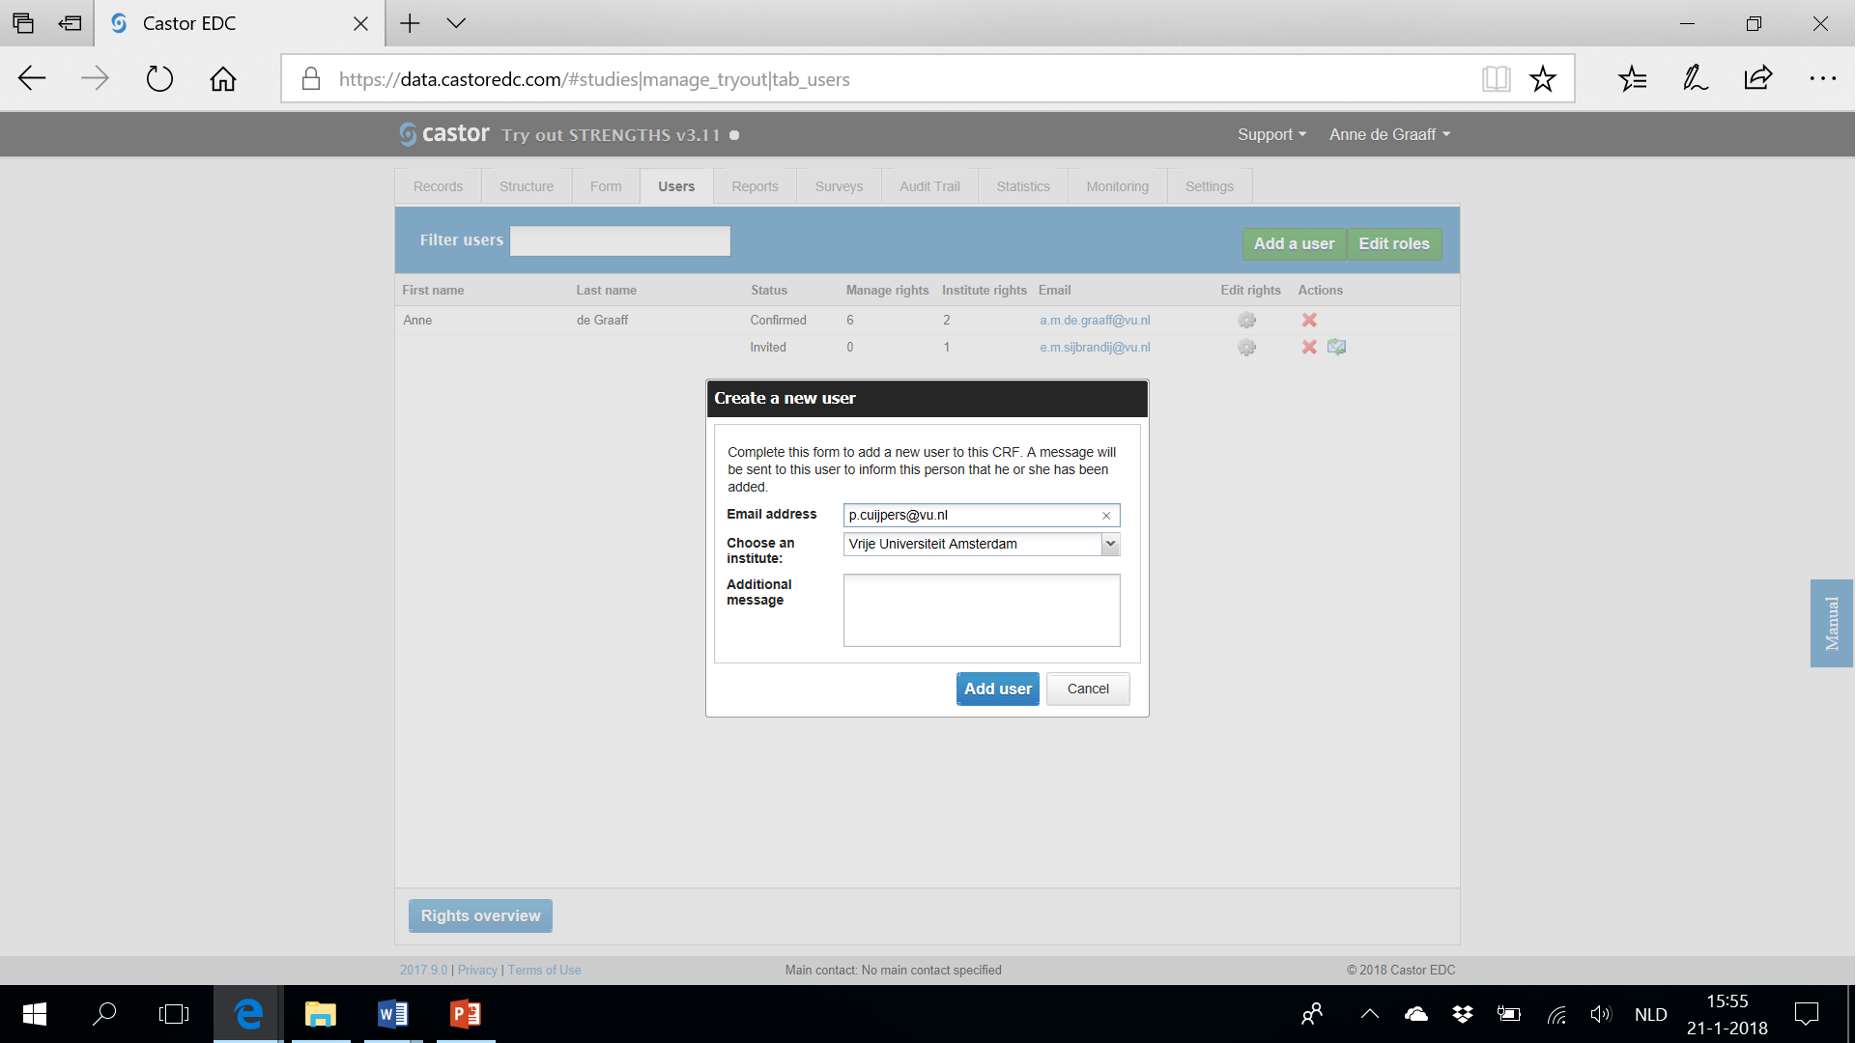
Users
Add Users (with Restrictions)

Slide 6
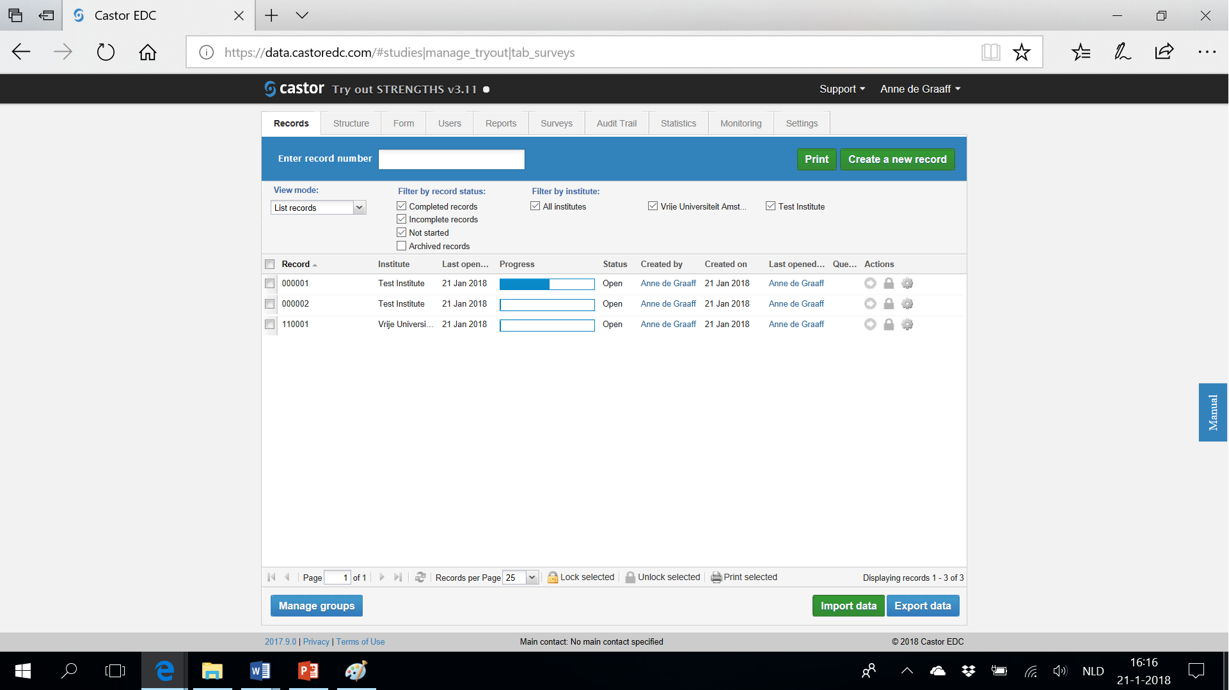
Patient Record Forms
Overview Participants, Progress, Actions
Data manager able to:
Change structure of the study
Create/change forms and reports
Define users’ rights
Define settings (e.g., randomization)
Assessors access to selected functions only

Slide 7
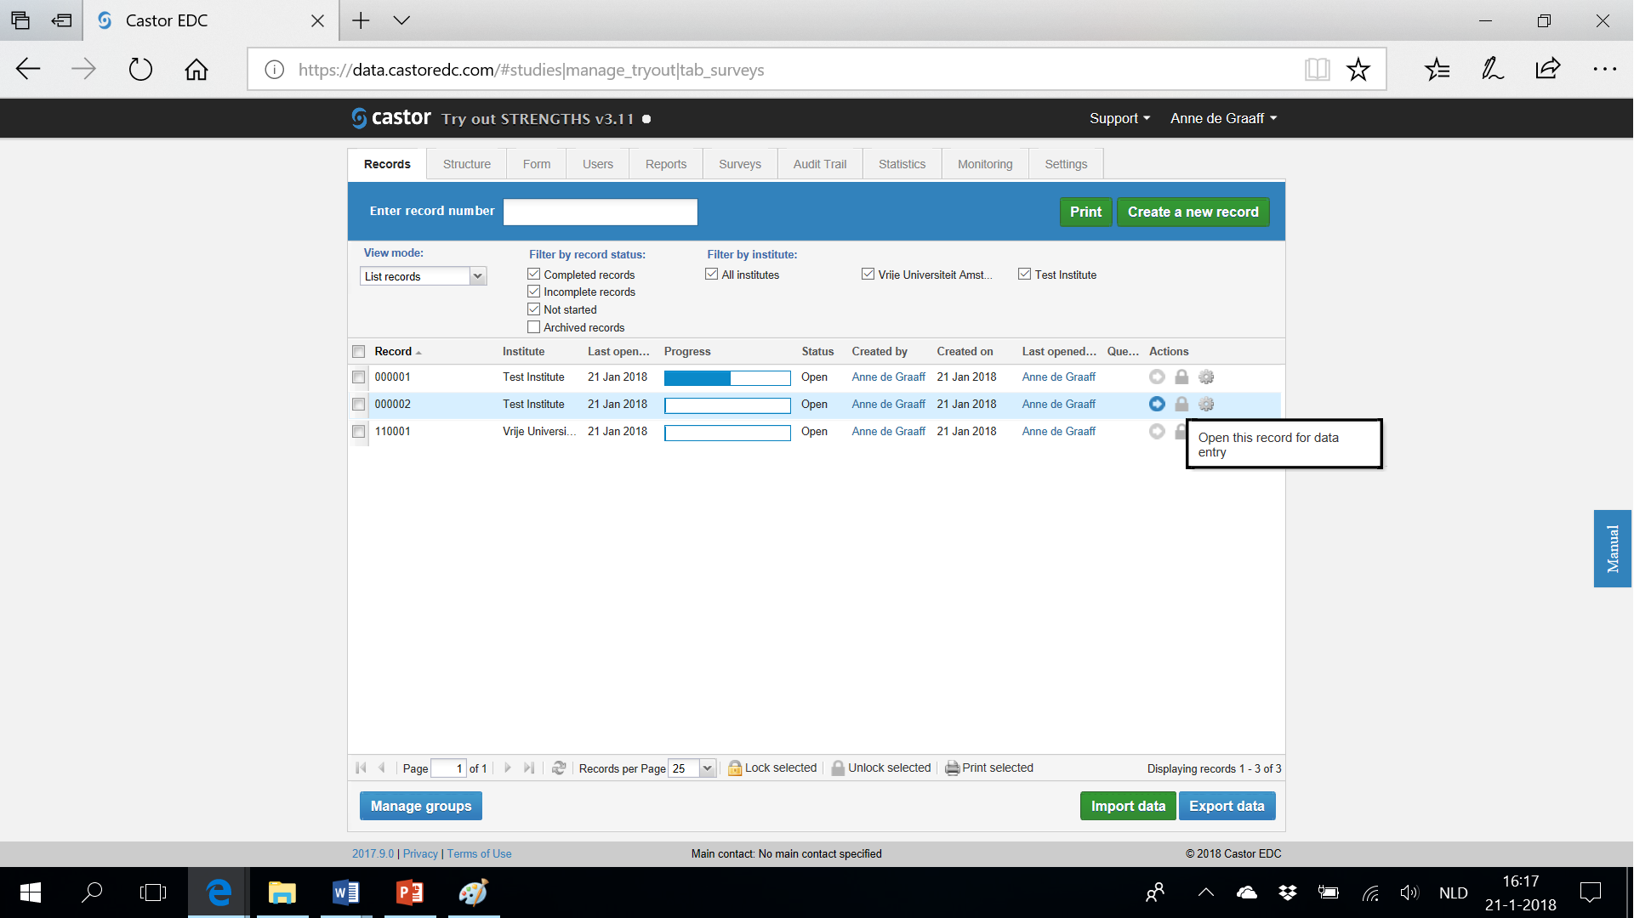
Patient Record Forms
Overview Participants, Progress, Actions
If randomization is on: PM+ or control indicated in column here;
Not visible for assessors

Slide 8
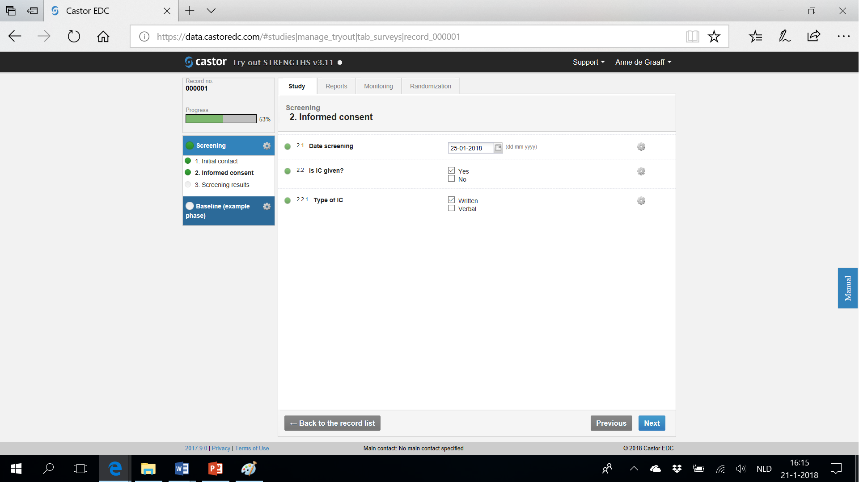
Data Entry

Slide 9
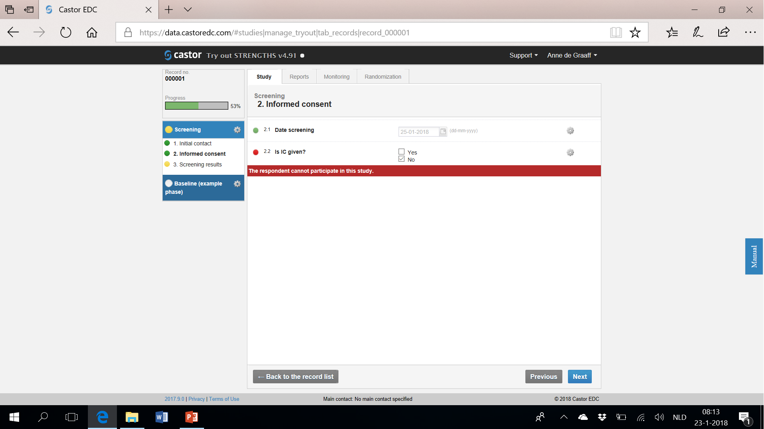
Data Entry
Once an exclusion message occurs you cannot proceed with other forms and therefore cannot randomize

Slide 10
Data Entry
Add study phases (e.g., randomization, treatment fidelity and other indicators, post assessment, etc.)

Slide 11
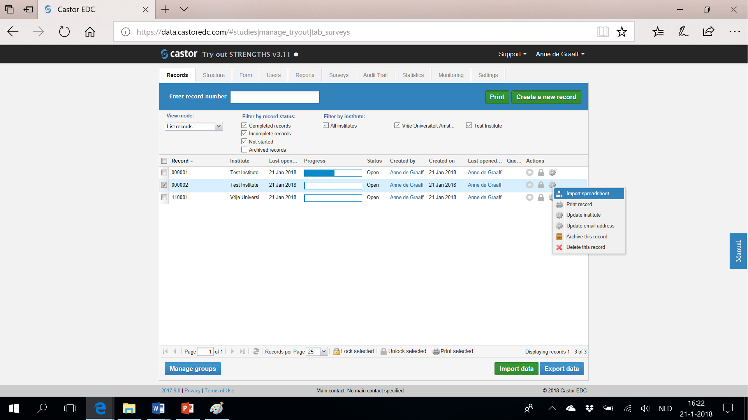
Patient Record Forms
Import Data From Excel
Imported data should have the exact same variable names as used in Castor EDC

Slide 12
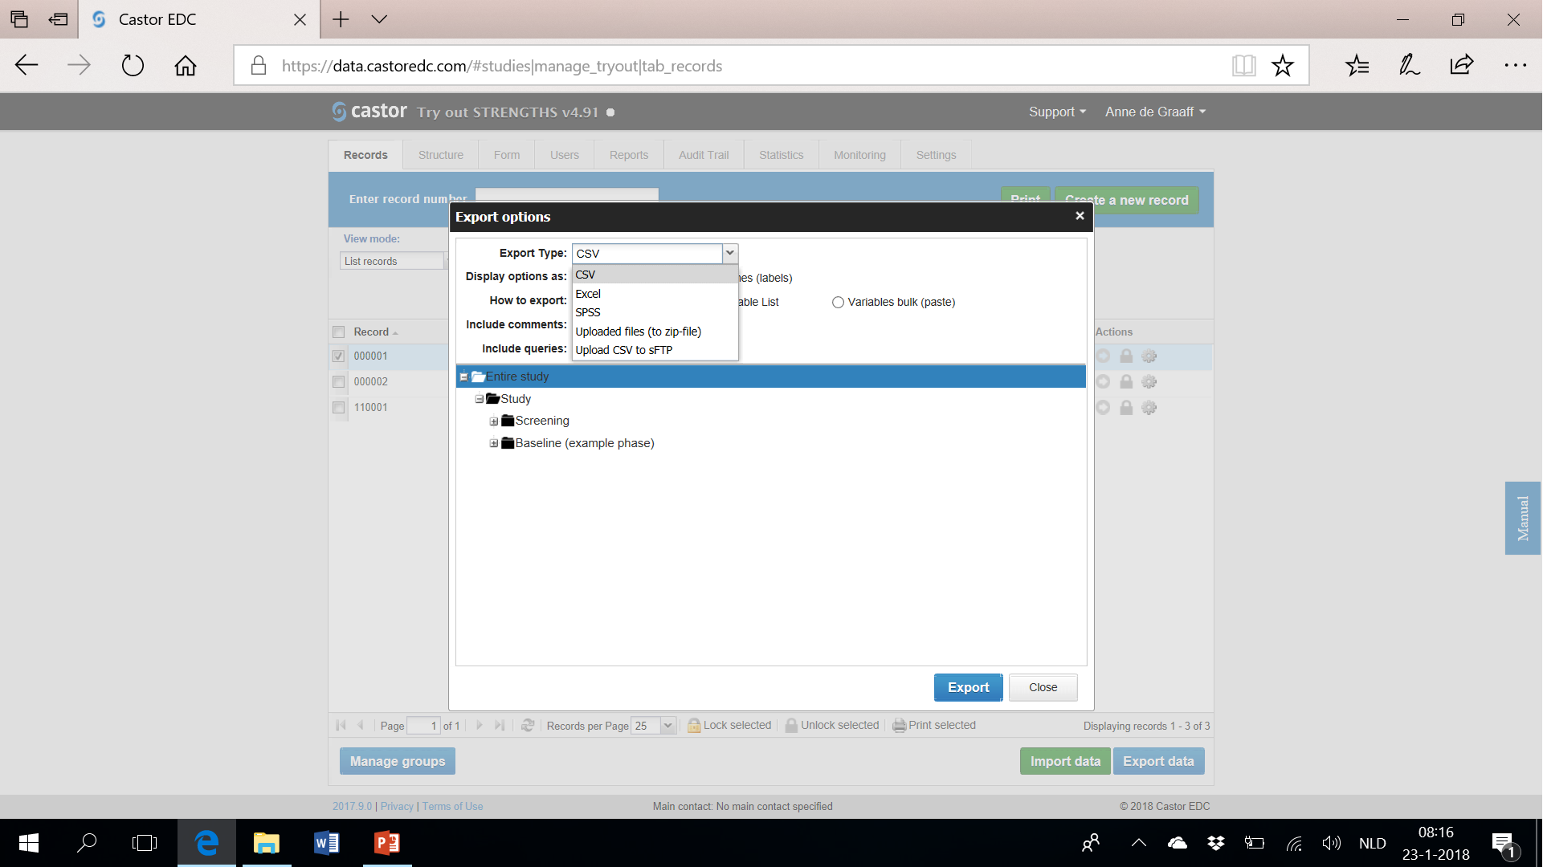
Patient Record Forms
Export Data From Castor EDC

Slide 13
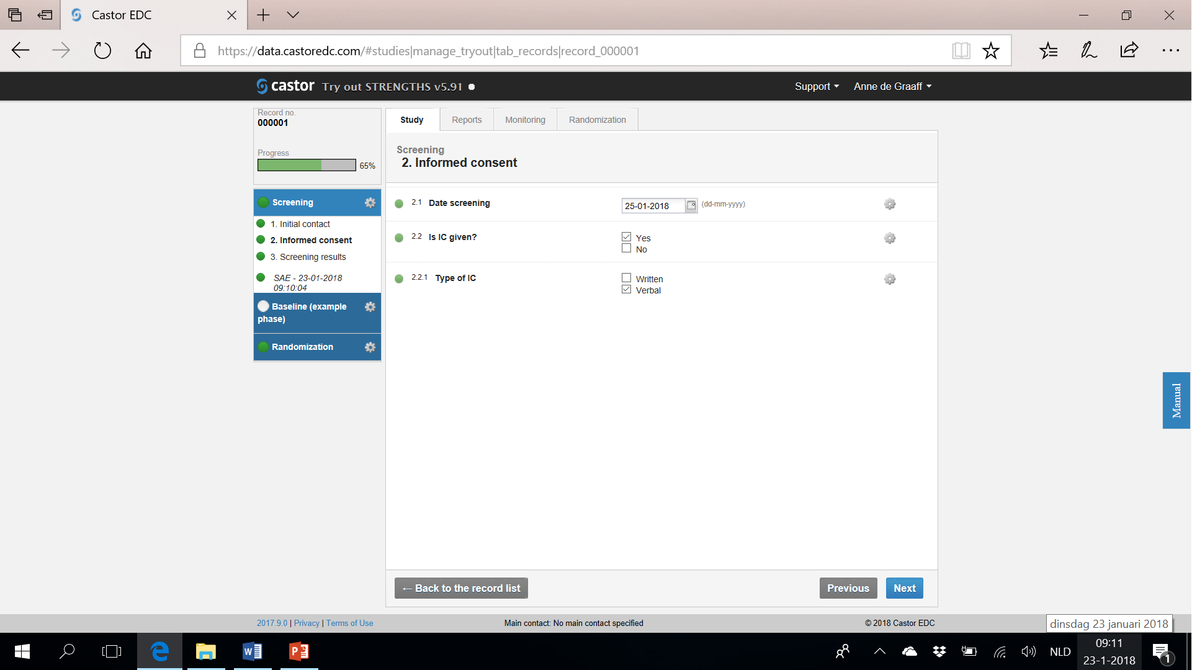
Reports
Adverse Events, …

